Slide 1
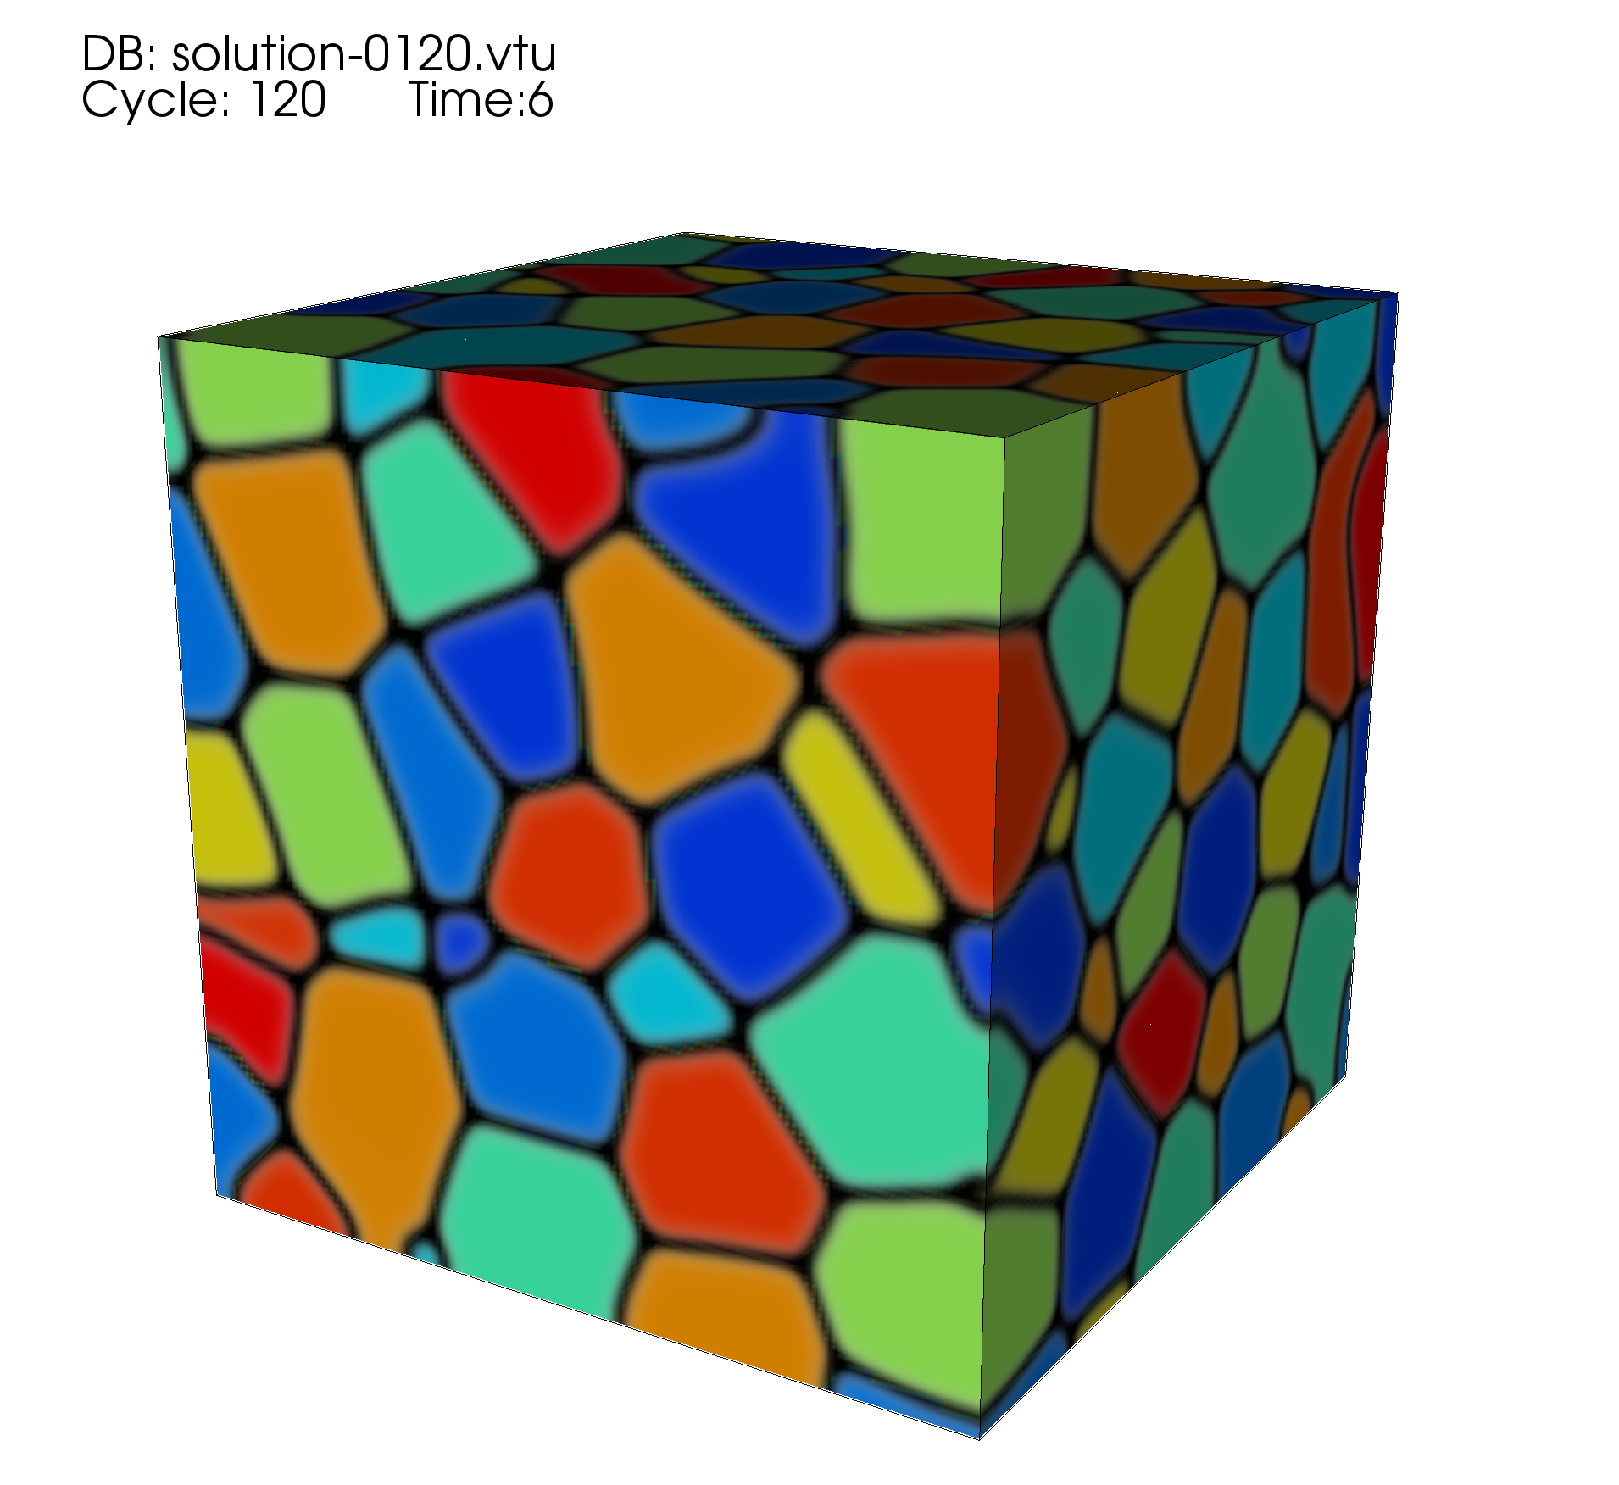
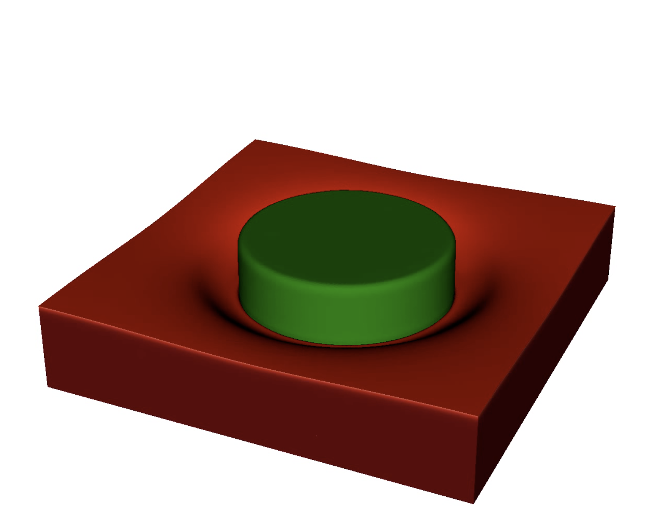
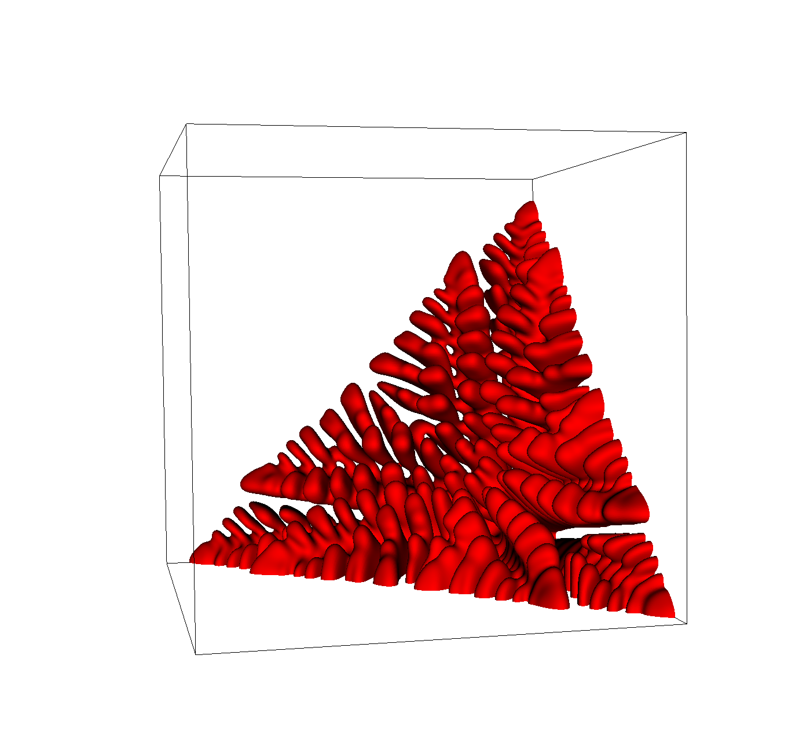
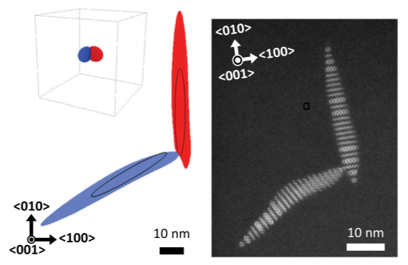
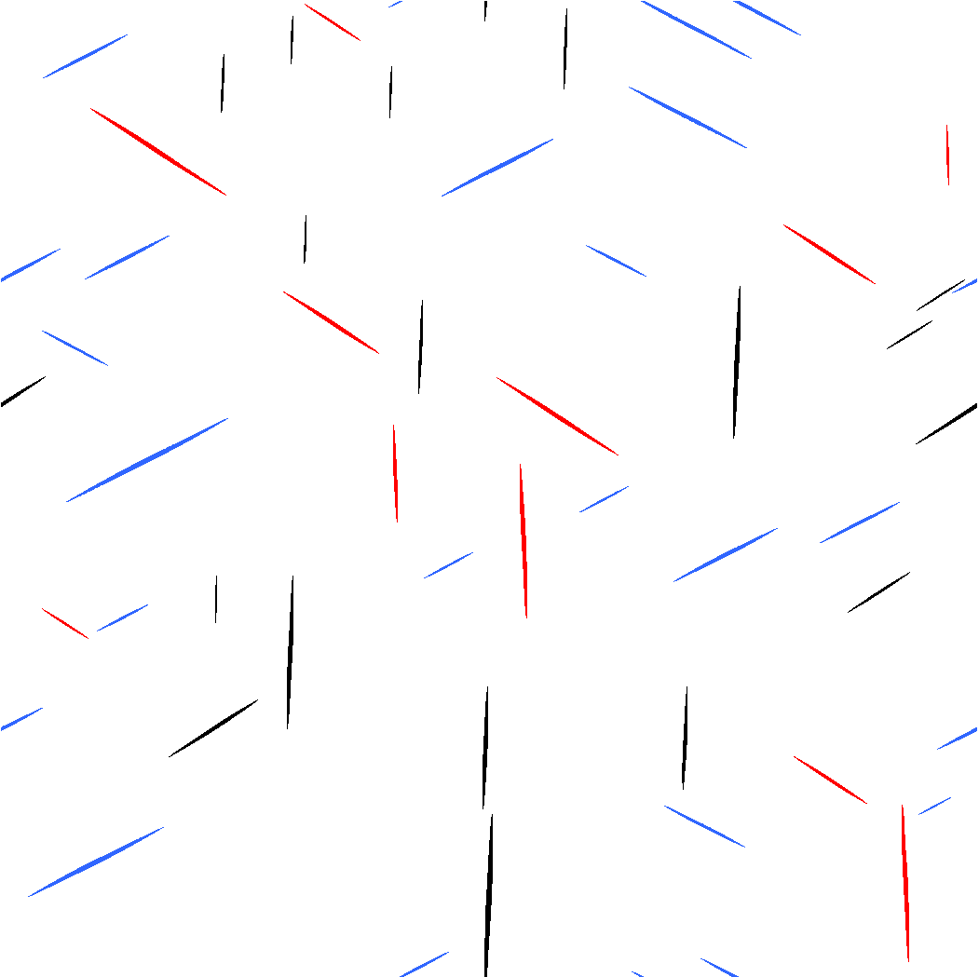
PRISMS Center Annual Workshop
August 3-6, 2021
PRISMS-PF Training Session I
David Montiel
Department of Materials Science and Engineering, University of Michigan
Notes:
Hello everyone, thank you all for being here. I am David Montiel, a staff scientist at the PRISMS Center and the lead developer of the PRISMS-PF framework.
I hope you find this training sessions useful.

Slide 2
Overview
Introductions to the Phase Field Method (~30 mins)
Introduction to PRISMS-PF (~30 mins)
Q&A Period (~10 mins)
Interactive demo session (50 mins)
A set of exercises and some useful links will be sent to all participants on the second half of the session.
If there is any time left, you can start working on the problem set.
We will spend the entire session on Wednesday answering questions about the exercises (and PRISMS-PF usage in general)
Notes:
Introductions to the Phase Field Method (~30 mins)
Introduction to PRISMS-PF (~30 mins)
Q&A Period (~10 mins)
Interactive demo session (50 mins)
A set of exercises and some useful links will be sent to all participants on the second half of the session.
If there is any time left, you can start working on the problem set.
We will spend the entire session on Wednesday answering questions about the exercises (and PRISMS-PF usage in general)

Slide 3
Announcements
To simultaneously follow the steps of the interactive part on your computer you must have installed…
PRISMS-PF
VisIt (or ParaView) for results visualization
This session will be recorded. I will make sure you have access to it ASAP so you can follow the demo part on your own.
Please make sure you are muted and your video is disabled
Post your questions on the chat and I will try to answer them all during the question period
During the interactive session, Bonnie Whitney and ‪Kubra Karayagiz will be answering the questions you post on the chat. We will create two breakout rooms in case you a question requires more time to answer.
Notes:
To simultaneously follow the steps of the interactive part on your computer you must have installed
PRISMS-PF
VisIt (or ParaView) for results visualization
This session will be recorded. I will make sure you have access to it ASAP so you can follow the demo part on your own.
Please make sure you are muted and your video is disabled
Post your questions on the chat and I will try to answer them all during the question period
During the interactive session, Bonnie Whitney and ‪Kubra Karayagiz will be answering the questions you post on the chat. We will create
two breakout rooms in case you a question requires more time to answer.

Slide 4




Funding and Computational Resources
Funding and Computational Resources
Award No.: DE-SC0008637
Notes:
Before I forget I would like to thank the Department of Energy for funding, and NERSC, XSEDE and Advanced Research Computing at the University of Michigan for computational resources.

Slide 5

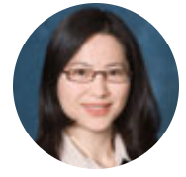



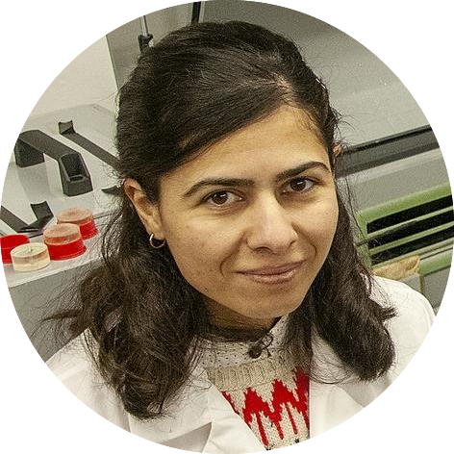






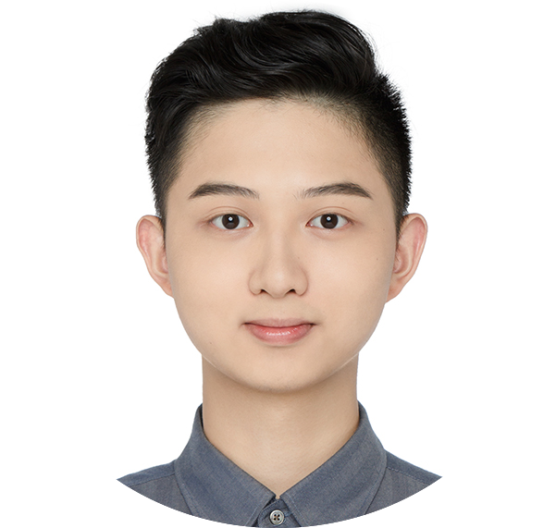







Contributors and Developers
Katsuyo Thornton
John Allison
Shiva Rudraraju
Stephen DeWitt
Beck Andrews
Yanjun Lyu
Zhenjie Yao
Bryan Kinzer
Kübra Karayağız
Bonnie Whitney
Pushkar Pandit
Nicole Schuman
Susan Gentry
Thomas Flint
Xianyue Liu
Notes:
I also want to thank the contributors and developers to PRISMS-PF, starting with Katsuyo Thornton, who is the head of phase field development at the PRISMS Center (also I want to mention that I took quite a bit of material for this presentation from one of her lectures, I hope she doesn’t mind). And John Allison who is the director of the PRISMS Center.
And then I also want to thank the people who have been involved in the of features or applications of PRISMS-PF, starting with two major contributors: Shiva Rudraraju (now at the University of Winsconsin-Madison), who started the framework and Stephen DeWitt (now at Oak Ridge National Lab), who developed many of the current functionalites.
Also, current and past developers from U of M,
Yanjun Lyu
Zhenjie Yao
And Beck Andrews
from Michigan
And from other institutions, we have:
Kubra Karayagiz and Bonnie Whitney from WPI
Nicole Shuman and Susan Gentry from UC Davis
Pushkar Pandit from the Indian Institute of Technology in Hyderabad in India
Tom Flint from the University of Manchester, UK
And Xianyue Liu from the Southern University of Science and Technology in China
Finally, I want to give special thanks to Bonnie Whitney, Kubra Karayagiz and Bryan Kinzer for volunteering to help in these training sessions

Slide 6
The Phase-Field Method

Slide 7
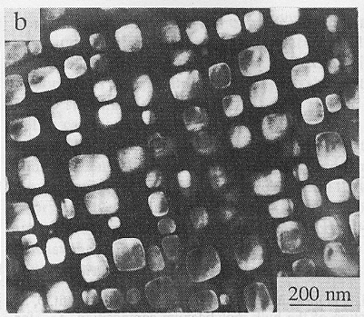
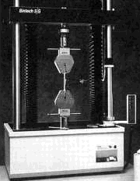

Motivation - The Paradigm of Materials Science
Processing
Structure
Fahrmann, et al., Acta Met. 45,1007 (1995)
Ni_3Al precipitates in a Ni-Al matrix
Properties
Performance
Notes:
So, before we go into the phase field model, let’s take a step back to look at where this model fits within the paradigm or materials science.
The goal of materials science and engineering is to improve existing materials or develop novel materials performance by understanding the relationship between processing, structure, properties and performance.
Processing alters the atomic structures and microstructures of materials.
And then structure determines the properties of these materials. Some properties are desirable and improve the performance of materials and others are not.
For example, here is the microstructure of an alloy used in the turbine blade of an airplane. As you can imagine this material is subject to continuous high stress at very high temperatures. So, it needs to be creep resistant in order to withstand this conditions. And it turns out having these squared shape particles that you see in there (which are precipitates) is what make this material resistant to deformation.
So we need to to be able to design a process that gives you this microstructure, and in order to do that we need to understand the underlying mechanisms involved in the formation of this array of precipitates.
…And that is where phase field models come in.
(Precipitates are Ni_3Al in a Ni-Al matrix. The arrangement of this precipitates prevents creep.)

Slide 8
Phase-Field Modeling
In essence, phase field modeling is a method to simulate microstructure evolution, and in particular the evolution of interfaces and compositions of different constituents in a material.
These simulations help us to understand the underlying mechanisms that give rise to different microstructures
Being able to predict microstructure evolution is a powerful tool in the design processes that will give us a set of desired properties and performance
Notes:
In essence, phase field modeling is a method to simulate microstructure evolution, and in particular the evolution of interfaces and compositions of different constituents of a material.
These simulations help us to understand the underlying mechanisms that give rise to different microstructures
And being able to predict microstructure evolution is a powerful tool in the design processes that will give us a set of desired properties and performance

Slide 9

Phase Field Applications - Grain Growth
Notes:
So let me give you some examples of phase field applications. These are all simulations performed with PRISMS-PF
Let’s start with grain growth, which is a process that occurs typically in a solid metal or alloy, and it is driven by a reduction of internal energy which is achieved by decreasing the total area of grain boundaries (those dark regions).
[play movie]
So, each of the grains are single crystals
And the grain boundaries separate crystals of different orientations. This is a very commonly observed phenomenon.

Slide 10
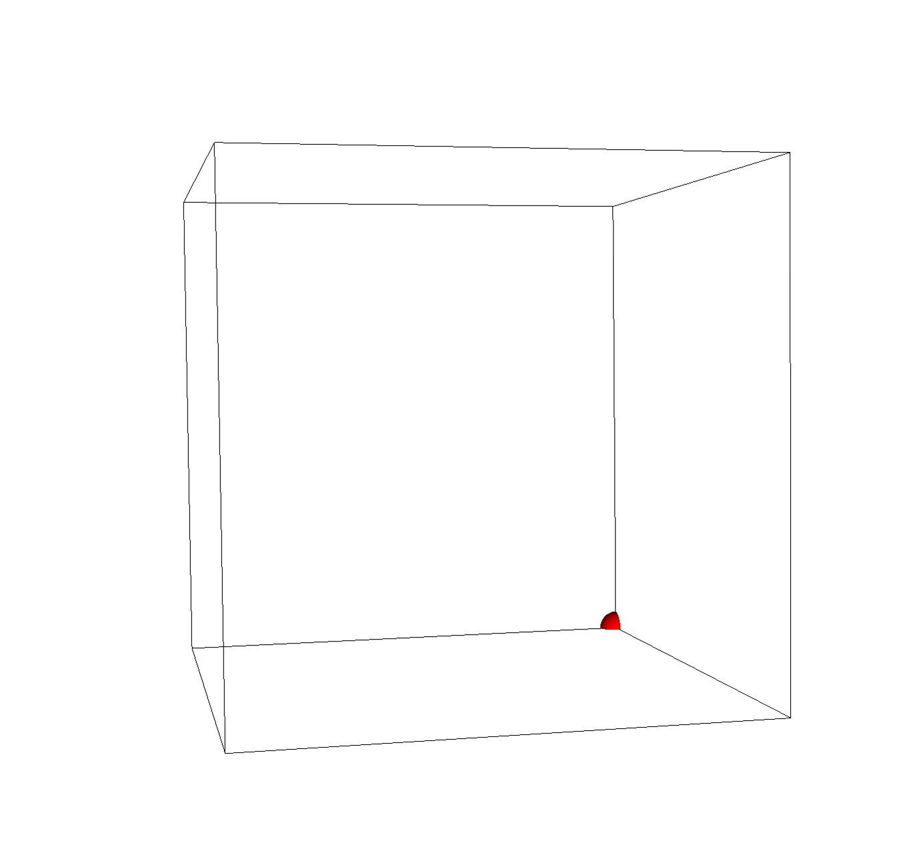
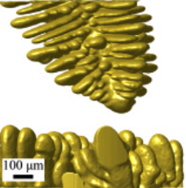
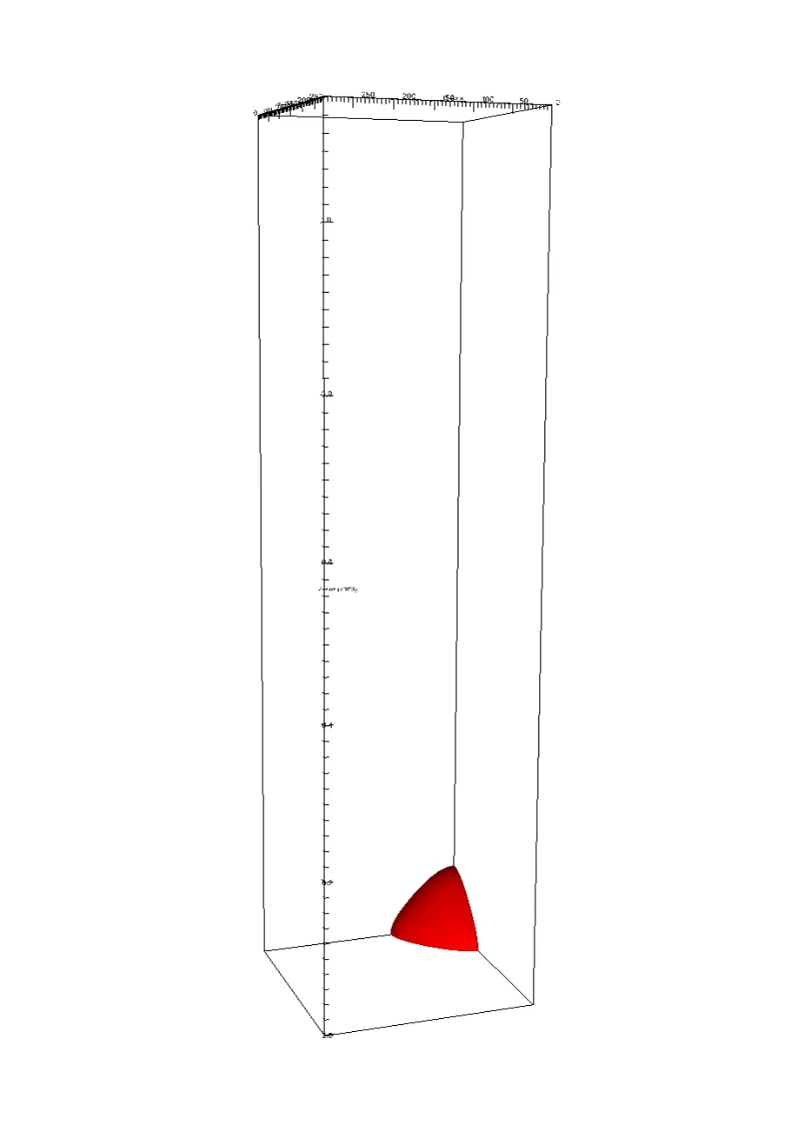
Phase Field Applications – Alloy solidification
Experiment
Zhenjie Yao et al.
In preparation (2021)
Equiaxed
Dendrites in Al-Cu alloy solidification
Elder et al., Scripta Mater. (2020)
Directional
Notes:
Another example is alloy solidification, which is typical of a casting process.
[play movie[
And what happens here is that an instability occurs at the solid-liquid interface and this gives rise to a dendritic structure (those branches you see).
The figure on the left is actually a four-dimensional X-ray computed tomography (XCT) from an actual dendritic growth experiment,
And the animation show equiaxed solidification (under uniform temperature) and directional solidification (under a temperature gradient and constant cooling).

Slide 11
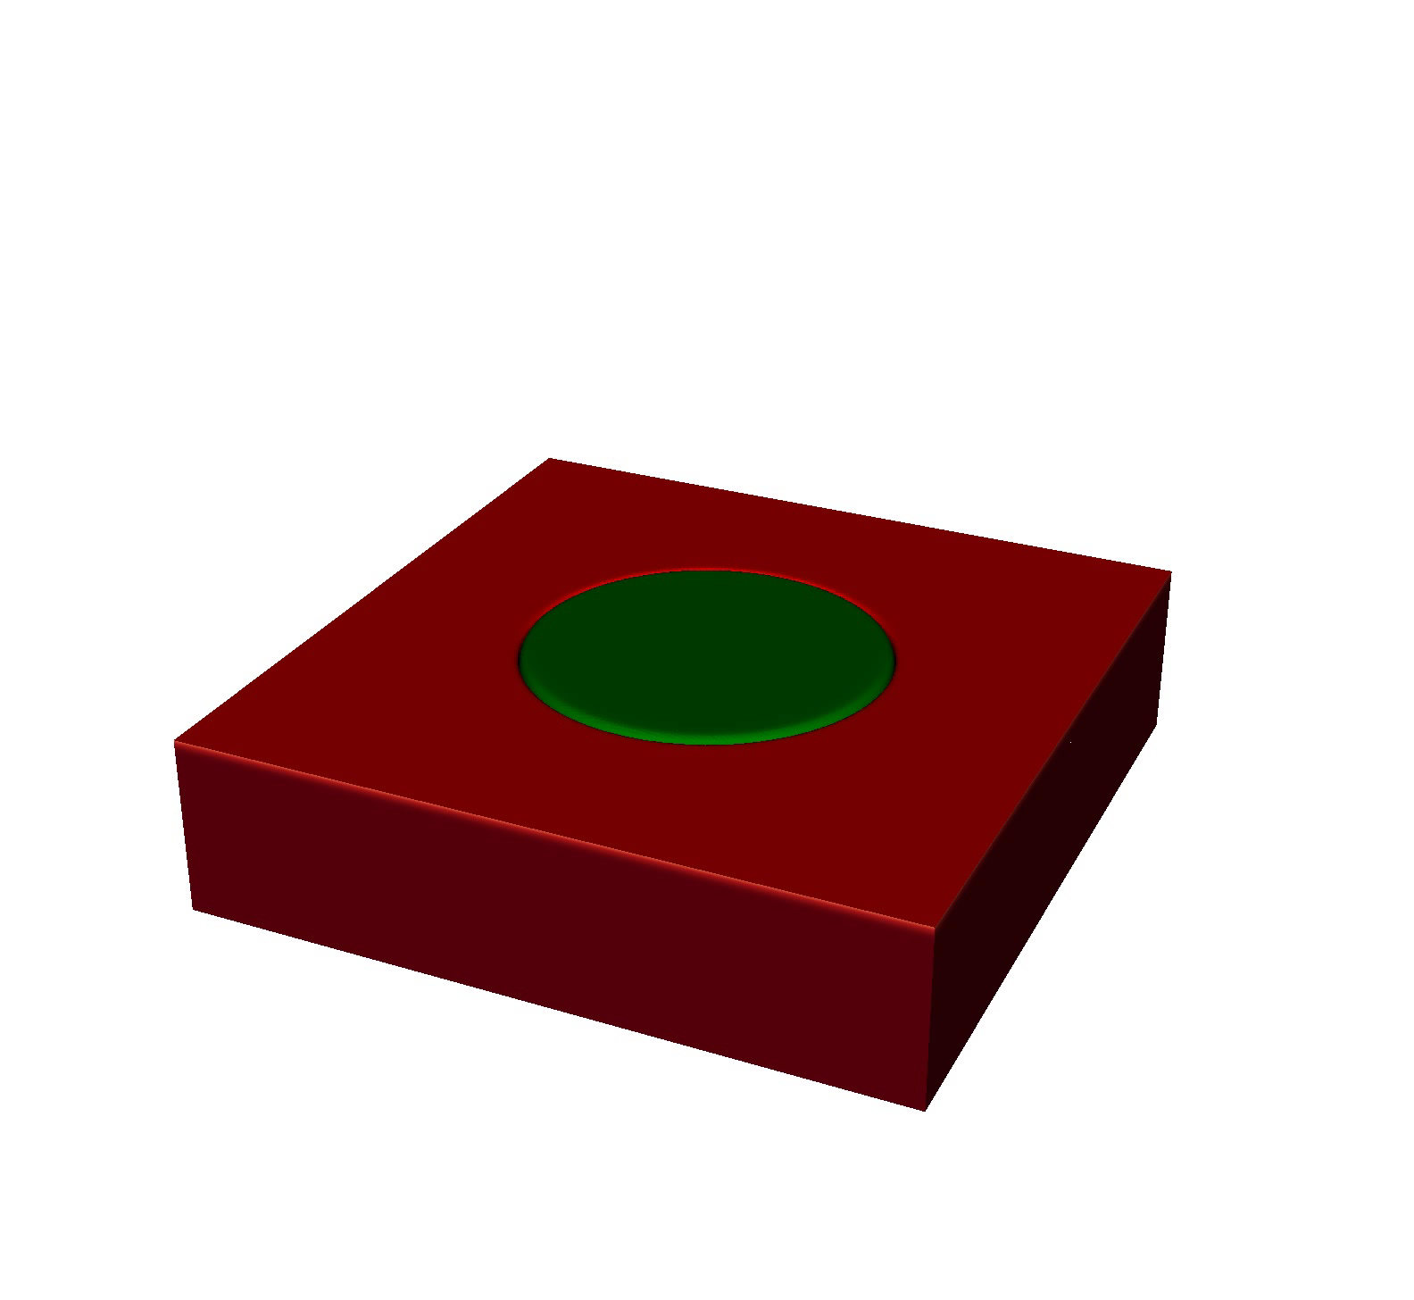
Phase Field Applications - Corrosion
Electrolyte
Fe particle
Mg
Notes:
Let me show another one. This one is for corrosion.
What we are seeing here is the surface of a metal (which in this case is pure Magnesium) and part of that surface is also occupied by an Iron particle. And the top of the surface is in contact with an electrolyte.
[play movie
And what we this is showing is an example of microgalvanic corrosion, in which the more noble metal (which is Iron, in this case) is acting as a cathode, and magnesium is acting as an anode. This is why we observe the corrosion front to move faster close to the Iron particle.

Slide 12
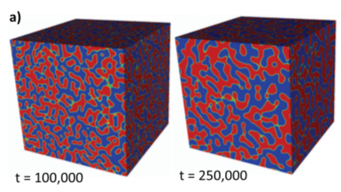
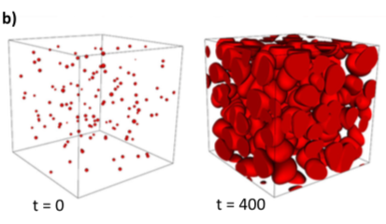
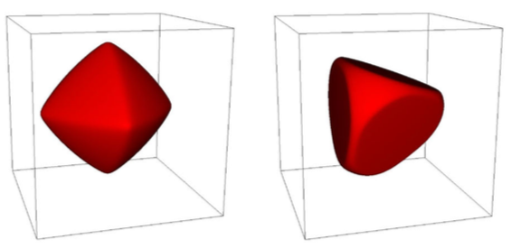
PRISMS-PF Applications
Spinodal decomposition and coarsening
Nucleation and growth of particles
Evolution of particles with strong interfacial anisotropy
Interaction between Mg-Nd alloy precipitates
DeWitt, S. et al., Acta Mater. 136, 378–389 (2017)
Notes:
And here are a few more examples
From the top-left, we have:
Spinodal decomposition and coarsening
Nucleation, growth, and coarsening of particles
On the bottom left we show particles featuring strong interfacial anisotropy after they have evolved from an initially spherical shape. The reason they have different shapes is because each particle has a different form of the anisotropy function.
And on the bottom right we show a simulation of the interaction between Magnesium-Neodymium precipitates. This last figure also shows a pretty good agreement with experiments in terms of morphology and relative orientation between the precipitates.

Slide 13
The Idea Behind the Phase-Field Model
To model microstructure evolution, we need a method to describe and track interfaces
If we treat interfaces as sharp 2D surfaces, the interfacial location must be tracked by markers. This is called the sharp interface model
Challenging free boundary problem - mathematically and computationally intensive.
Notes:
OK but let’s go back to the model itself. What is the idea behind it?
In order to model microstructure evolution, we need a method to track interfaces.
If we treat interfaces as sharp 2D surfaces, the interfacial location must be tracked by markers.
This is called the sharp interface model
And this is typically a challenging problem to solve numerically because it is mathematically and computationally expensive

Slide 14
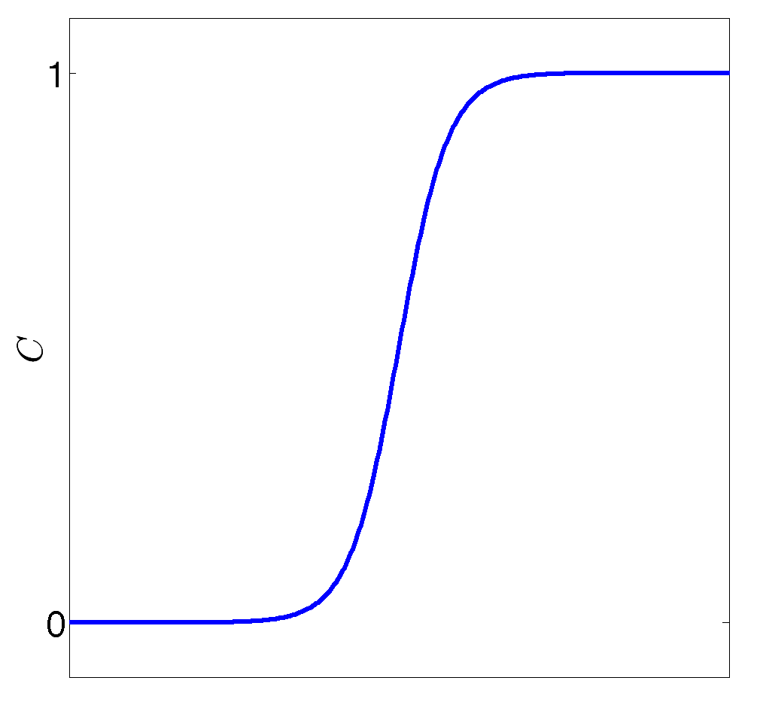
The Idea Behind the Phase-Field Model
The phase-field model considers interfaces to be regions that have a finite volume where bulk quantities (order parameters) change gradually.
Bulk quantities such as concentration are governed by partial differential equations (PDEs).
β phase
interface
α phase
Interfaces are identified as the regions where bulk quantities take their interfacial values
The same PDEs can be applied everywhere (including the interface regions) thereby eliminating the need to explicitly track the interface
Notes:
Instead of that, phase field, considers a diffuse interface that is thin but not completely sharp.
The interface is then a region that occupies a small volume where quantities change gradually between two bulk values
Bulk quantities are governed by PDEs
Interfaces can be identified as the regions where bulk quantities take their interfacial values
The big advantage here is that the same PDEs can be applied everywhere (including the interface regions) and that eliminates the need to explicitly track the interface

Slide 15
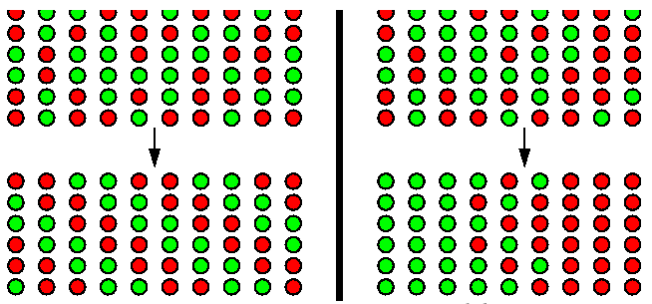
Order Parameter
The evolution of interfaces is characterized using order parameters
An order parameter is a continuous field that characterizes each phase
Each order parameter has a governing equation (PDE) associated with it.
Order parameters can be classified as conserved or non conserved
Order-disorder transition
Non-conserved order parameter
Spinodal decomposition
Conserved order parameter
Notes:
The evolution of interfaces is characterized using order parameters
An order parameter is a continuous field that characterizes each phase.
Each order parameter has a governing equation (PDE) associated with it.
And order parameters can be classified as conserved or non conserved
So, for example on the left side, we are showing an order-disorder transition (and that is characterized by a non-conserved order parameter) and on the right we have and example of spinodal decomposition, which is characterized by a non-conserved order parameter.

Slide 16
What Determines Microstructure Evolution?
Thermodynamics and Kinetics (Dynamics)
The equilibrium state is the state for which the free energy is a minimum
For bulk phases, this state can be determined using phase diagrams and is characterized by a uniform chemical potential.
Systems featuring complex microstructures observed in materials are not in thermodynamic equilibrium
However, their evolution is still driven by the minimization of the free energy
The driving force for phase transformation is proportional to the gradient of the chemical potential, but there is kinetic factor that determines how fast this transformation occurs.
Notes:
The equilibrium state is the state where the free energy is a minimum
For bulk phases, this state can be determined using phase diagrams and is characterized by a uniform chemical potential.
So, systems featuring complex microstructures observed in materials are not in thermodynamic equilibrium
However, their evolution is still driven by the minimization of the free energy
And the driving force for phase transformation is proportional to the gradient of the chemical potential

Slide 17
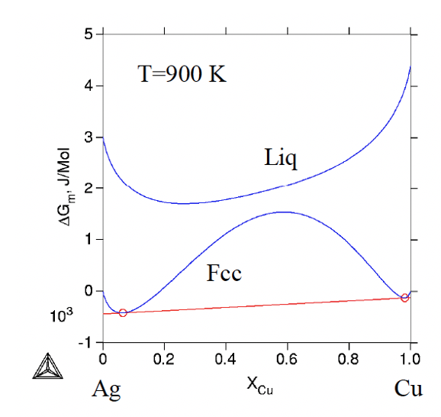
Dynamics
Order parameter, φ
C_{β}
C_{α}
Let F {φ(r)} be the free energy of the system which includes bulk and interfacial contributions
C
Chemical potential:
Notes:
So how can we write that?
For example if we have a system for which different phases are characterized by different equilibriums compositions, we can define an order parameter that depends linearly on that composition
Suppose we have can write a free energy expression, F, for the whole system
that depends on the value of πηι, which varies spatially
Then the chemical potential is defined as the variational derivative of F with respect to phi.

Slide 18
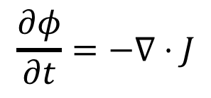
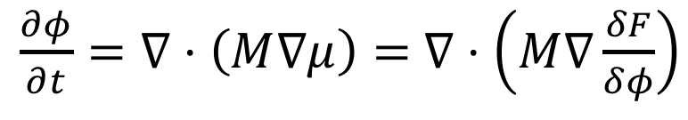
Cahn-Hilliard Dynamics
Flux:
$$\frac{∂φ}{∂t}=−∇⋅J$$
Mass conservation:
Chemical potential:
Combine all:
$\frac{∂φ}{∂t}=∇⋅\left(M∇μ\right)=$ $∇⋅\left(M∇\frac{δF}{δφ}\right)$
The Cahn-Hilliard equation
Notes:
Now, if you remember the form of the diffusion equation, we have a flux that is proportional to the concentration gradient. But now we can generalize it as a chemical potential gradient, with M being a mobility instead of a diffusivity.
Then we can combine this with an expression for mass conservation, which is the second line
And the expression for the chemical potential, from the last slide
And arrive to the Cahn-Hilliard equation (which is almost identical to the diffusion equation but with the gradient of mu instead of c)
By the way you, I am not going to do it right now, but you can prove that for a bulk phase, the Cahn-Hillard equation just becomes the diffusion equation.
OK now, what is missing? What else do we need. Well, we need an expression for the free energy.

Slide 19
Free Energy
C_{β}
C_{α}
C
Notes:
So, the simplest approximation for the free energy of the system consists of two terms:
The first one considers the energy of a homogeneous phase as a function of concentration. And you can get that from a thermodynamic database like Thermocalc. (by the way, I just noticed this is written in terms of ”c” not phi, but just consider ”c” to be the rescaled concentration)

Slide 20
Free Energy
“Double well” free energy with minima at and
Notes:
Anyway, in practice, usually a simple polynomial approximation is good enough. This form is commonly called a double well.

Slide 21
Free Energy
“Double well” free energy with minima at and
Notes:
And the second contribution is effectively a penalty for having sharp gradient and so it forces the interface to be smooth. Notice also that this term increase as the interfacial area increases, so it is consistent with what is expected from a free energy expression.

Slide 22
Free Energy
“Double well” free energy with minima at and
Dynamics:
Notes:
OK, so now if we go back to the Cahn-Hilliard equation for the dynamics.
Now we can obtain the variational derivative dF/dc from the free energy expression and solve the equation numerically.

Slide 23
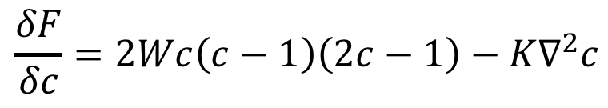
Free Energy
“Double well” free energy with minima at and
Dynamics:
$$\frac{δF}{δc}=2Wc\left(c−1\right)\left(2c−1\right)−K∇^{2}c$$
Notes:
This actually, gives this line, which is not to complicated to obtain.

Slide 24
Free Energy
“Double well” free energy with minima at and
Dynamics:
$$\frac{δF}{δc}=2Wc\left(c−1\right)\left(2c−1\right)−K∇^{2}c$$
Notes:
This actually, gives this line, which is not too complicated to obtain.

Slide 25
Allen-Cahn Dynamics
Free energy
functional
“Double well” free energy with minima at and
Dynamics
Notes:
Now if we consider the same form of the free energy but for a non-conserved order parameter, we get the Allen-Cahn equation, which is even simpler.
The only difference here is that, since the order parameter is not conserved, the local time derivative of order parameter will simply be proportional to the chemical potential, and this equation gives us the fastest path to minimize the global free energy.
I should also mention that the Allen-Cahn equation describes phenomena where dynamics are governed by the mean curvature at interfaces, such as order-disorder transitions in binary alloys and grain growth (by using multiple order parameters).

Slide 26
Remarks
Most phase field formulations employ the governing equations we’ve covered today to describe the evolution of order parameters
Depending on the system we want to study, we can incorporate different “physics” into the free energy (e.g., elasticity, interaction between different order parameters, interaction with an external electric or magnetic field, etc.)
Many applications of the phase field model require multiple orders parameter that need to be solved simultaneously
Notes:
OK so we’ve kind of covered the basics of the phase field model. We are going to revisit this later today but with an emphasis on the numerical solution of the equations.
But for now I would like to mention that
Most phase field formulations employ the governing equations we’ve covered today to describe the evolution of order parameters
And depending on the system we want to study, we can incorporate different “physics” into the free energy (e.g., elasticity, interaction between different order parameters, interaction with an external electric or magnetic field, etc.), but the governing equations are derived using the same method
Also, many applications of the phase field models require multiple orders parameter that need to be solved simultaneously (for example alloy solidification requires the solution of coupled Allen-Cahn and Cahn Hilliard dynamics.

Slide 27
Questions?
Notes:
OK so we’ve kind of covered the basics of the phase field model. We are going to revisit this later today but with an emphasis on the numerical solution of the equations.
But for now I would like to mention that
Most phase field formulations employ the governing equations we’ve covered today to describe the evolution of order parameters
And depending on the system we want to study, we can incorporate different “physics” into the free energy (e.g., elasticity, interaction between different order parameters, interaction with an external electric or magnetic field, etc.), but the governing equations are derived using the same method
Also, many applications of the phase field models require multiple orders parameter that need to be solved simultaneously (for example alloy solidification requires the solution of coupled Allen-Cahn and Cahn Hilliard dynamics.

Slide 28
The PRISMS-PF framework

Slide 29
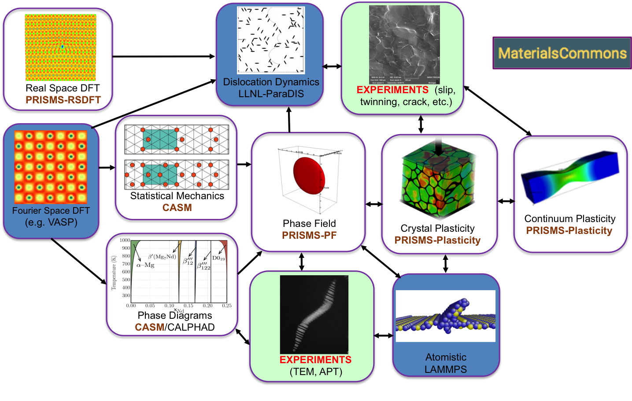
PRISMS Center Integrated Framework
Notes:
OK, so before I get into PRISMS-PF I would like to show how it fits within the PRISMS Center integrated framework (If you attended the workshop last week you’ve probably seen this slide)
As you can see, phase-field simulations are central to this framework, since they require thermodynamic and kinetic data that experiments or atomistic models can provide. And we use them to predict microstructure evolution, which in turn can be useful for experiments and other computational tools such as Crystal Plasticity Finite Element.

Slide 30
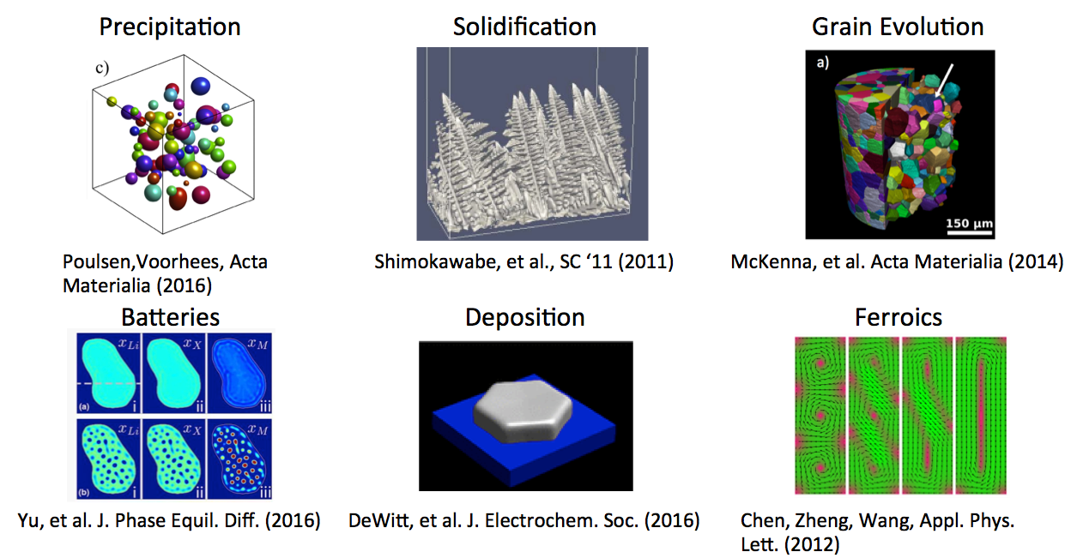
Motivation: What’s hard about writing a phase field code?
Wide diversity of models and coupled physics makes code reuse difficult
No “typical” governing equations
Large variety of formulations and terms
Notes:
OK, let’s talk about the motivation behind the development of PRISMS-PF.
Phase field models have a wide range of applications in simulating microstructure phenomena. I am just showing a few examples here.
For this reason, there isn’t really a typical governing equation for all phase field models. Instead, the governing equations need to be selected on a case-by-case basis, depending on the physics we want to describe.
As a consequence, we have a large variety of formulations and terms. So, a challenge for a phase-field framework is that it needs to be flexible enough to incorporate different governing equations.

Slide 31
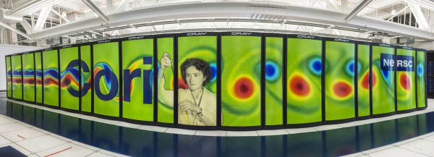
Motivation: What’s hard about writing a phase field code?
Simulating large, physically representative systems is computationally intensive
Simulations often take days on 10s-100s of cores
Simulations are often done in 2D for tractability
Physical fidelity requires strong numerical performance
nersc.gov
Notes:
Another challenge is that simulating a large, physically representative system is almost always computationally intensive, typically requiring tens or thousands of cores.
Because of this, many studies are often done in 2D. But accurate simulations in 3D require strong computational performance. This is why it is essential to have a scalable, high-performance framework to perform large simulations of complex microstructures.

Slide 32
Four Principles Guiding PRISMS-PF Development
Its computational performance, including parallel scalability, should meet or exceed that of typical phase field codes
It should accommodate a wide variety of phase field models and applications
The interface for creating or modifying governing equations should be simple, quick, and separate from the numerical implementation.
It should be open source with a permissive license so it is available to everyone and advances can be shared by the community
Notes:
Given these challenges, the PRISMS-PF framework was designed under four guiding principles:
First, that its computational performance, including parallel scalability, meets or exceeds that of typical phase field codes as well as that of the most common open-source codes.
Second, that it accommodates a wide variety of phase field models and applications.
Third, that the interface for creating or modifying governing equations is simple, quick, and separate from the numerical implementation.
And finally, that it is open source with a permissive license so it is available to everyone, and advances can be shared by the community.

Slide 33

prisms-center.github.io/phaseField
Advanced capabilities
Matrix-free finite element approach
Solution of an arbitrary number of coupled PDEs
Higher-order elements
Multi-level parallelism
Adaptive meshing
Explicit nucleus placement
Grain-remapping
Newton/Picard nonlinear solver
Implicit time integration capability <- Coming soon!
Functionalities / Ease of Use
Simple interface
Detailed online user guide
27 pre-built applications
Simple Docker-based installation
nanoHUB tool w/ GUI for educational use
Integrated with Materials Commons
Postprocessing scripts for results analysis
YouTube video tutorials
DeWitt et al., npj Comput. Mater. 6, 29 (2020)
Notes:
So, let’s go over some of the main features and capabilities of PRISMS-PF. This is the link to the website [point to upper-right] corner, where you can get an overview, access the repository, instruction manual, etc.
This code is based on the deal.II finite element library, and some of its advanced capabilities are
The use of a matrix-free approach, which employs efficient explicit time stepping by eliminating the need to diagonalize the mass matrix
The capability to solve for an arbitrary number of coupled Partial Differential Equations
The option to use linear, quadratic or cubic elements
Multilevel parallelism: that is, distributed memory parallelization, task-based threading and vectorization. (from the perspective of the user, this all happens in the background, so all the user needs to do is set the number of MPI processes at run time).
The use of adaptive meshing, which is very useful when we have regions in space (such as interfaces) where a high resolution is required, along with regions where fields vary slowly (typically bulk phases) that don’t need to be resolved as much.
Next, we have a method for explicit nucleus placement, based on a nucleation probability function that the user can define
A functionality for grain remapping, which can significantly reduce the computation time in grain growth simulations by assigning a small number of order parameters to track all grains in the system.
A Newton/Picard solver, which allows us to solve nonlinear ordinary differential equations at every time step. So, an example of this would be solving for the equilibrium electrostatic potential as the system evolves.
And coming very soon we will release a functionality to enable the use of an implicit method for time integration. This will provide a speed up for the solution of equations with highly nonlinear terms.
And on the right panel we have some of the functionalities and features that make it user-friendly, including
A simple interface, which means the typical user only needs to modify a few files in an application directory. And it is relatively straightforward to do so.
A detailed online user guide
A total of 27 built-in applications
A simple Docker-based installation option
A recently upgraded nanoHUB tool for educational use
Integration with the Materials Commons repository for easy data sharing
A new suite of postprocessing scripts for results analysis
And a new series of short video tutorials on YouTube which we plan to keep expanding
I also want to point out this reference [point to Ref.] to an article that we published about a year ago, where you can find a lot more details about the framework’s structure, features, performance, etc.

Slide 34
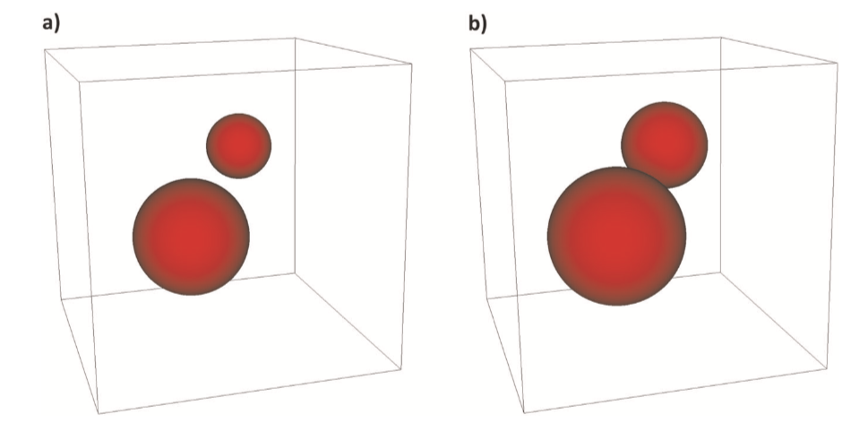
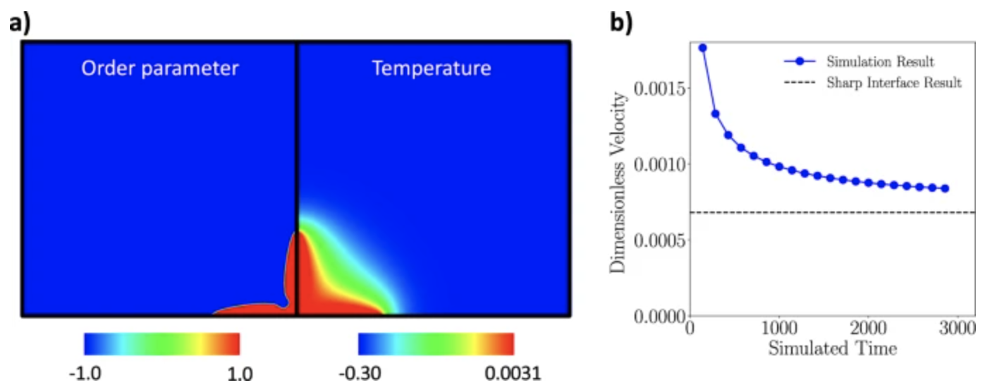
Performance of PRISMS-PF
Comparison to finite difference code
Two growing particles in 3D
Comparison to other Open Source Codes
Solidification benchmark problem
(https://pages.nist.gov/pfhub/benchmarks/benchmark3.ipynb/)
Element/Mesh Type | Speedup vs. FD*
Linear/Regular | 0.028
Quadratic/Regular | 0.90
Cubic/Regular | 1.9
Cubic/Adaptive | 12.0
*Fortran FD code
MPI parallelization
2nd order central difference derivatives
Explicit time stepping
PRISMS-PF performance was compared to MOOSE, AMPE and FiPy
The PRISMS-PF calculations required three orders of magnitude fewer normalized core hours than AMPE and FiPy, while having similar or lower error.
The fastest calculations using PRISMS-PF and MOOSE have similar computational cost and tip velocity error.
Comparison is at the same error with respect to a highly-resolved simulation in time in space
[DeWitt et al., npj Comput. Mater. 6, 29 (2020)]
34
Notes:
Let’s talk about performance.
As you may remember, one of our guiding principles for development was that PRISMS-PF’s computational performance meets or exceeds that of typical phase field codes and the most common open-source codes as well.
So first I want to show a comparison with a finite difference code. This code was written in Fortran with MPI parallelization, uses second-order central difference derivatives and explicit time-stepping.
We used this code to simulate a simple scenario of two particles growing in a 3D system according to coupled Cahn-Hilliard/Allen-Cahn dynamics.
We ran the same simulation in PRISMS-PF and compared the results with finite difference for the same error (with respect to a highly-resolved simulation in time in space)
In this table, you can see the comparison: If we use PRISMS-PF with linear elements and uniform mesh, finite difference is much faster. But once we get to quadratic mesh, the performance is comparable (although finite difference is still a little faster than PRISMS-PF).
However, once we go to adaptive mesh and cubic elements, PRISMS-PF is more than tenfold faster.
[show right panel]
Now, regarding other open-source codes, we compared the performance between PRISMS-PF, MOOSE, FiPy and AMPE for a 2D simulation of solidification in a pure material. This is one of the benchmark problems developed at the PFHub community (I’ve included the link to the problem) and, in summary, we found that:
1) The PRISMS-PF calculations required three orders of magnitude fewer normalized core hours than AMPE and FiPy, while having similar or lower degree of error.
2) The fastest calculations using PRISMS-PF and MOOSE have similar computational cost and tip velocity error.
I should add that, for this comparison, we only included results uploaded by expert-level users.
So, in conclusion, we are pretty confident that PRISMS-PF is competitive in terms of performance.

Slide 35
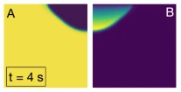
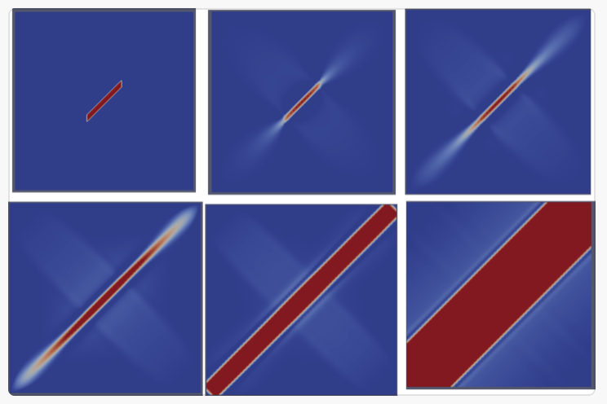
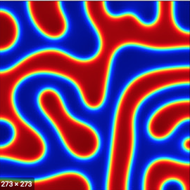
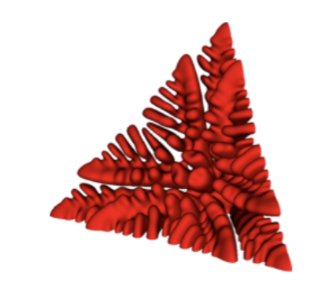
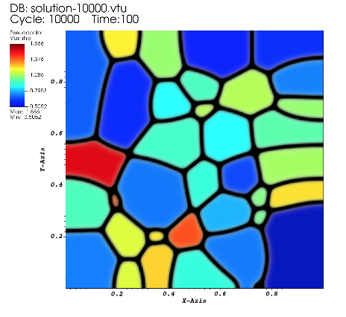
New and Upcoming Features - Built-in Apps
Recent
Coming soon
Corrosion
Microgalvanic Corrosion
Martensitic Transformation*
Spinodal Decomposition
Alloy Solidification
Grain Growth (with Stored Energy)
* Pushkar Pandit (IIT Hyderabad, India) and Bonnie Whitney (WPI)
35
Notes:
I want to briefly mention some built-applications that we released recently:
Corrosion, alloy solidification and spinodal decomposition
And a few more that are coming soon:
- Microgalvanic corrosion, grain growth with stored energy and martensitic transformation. This application is mostly a contribution from Pushkar Pandit from IIT Hyderabad, India and Bonnie Whitney from WPI

Slide 36

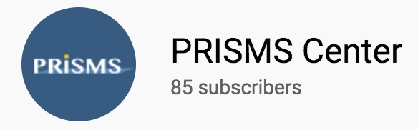
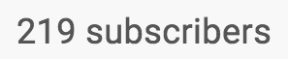
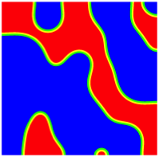
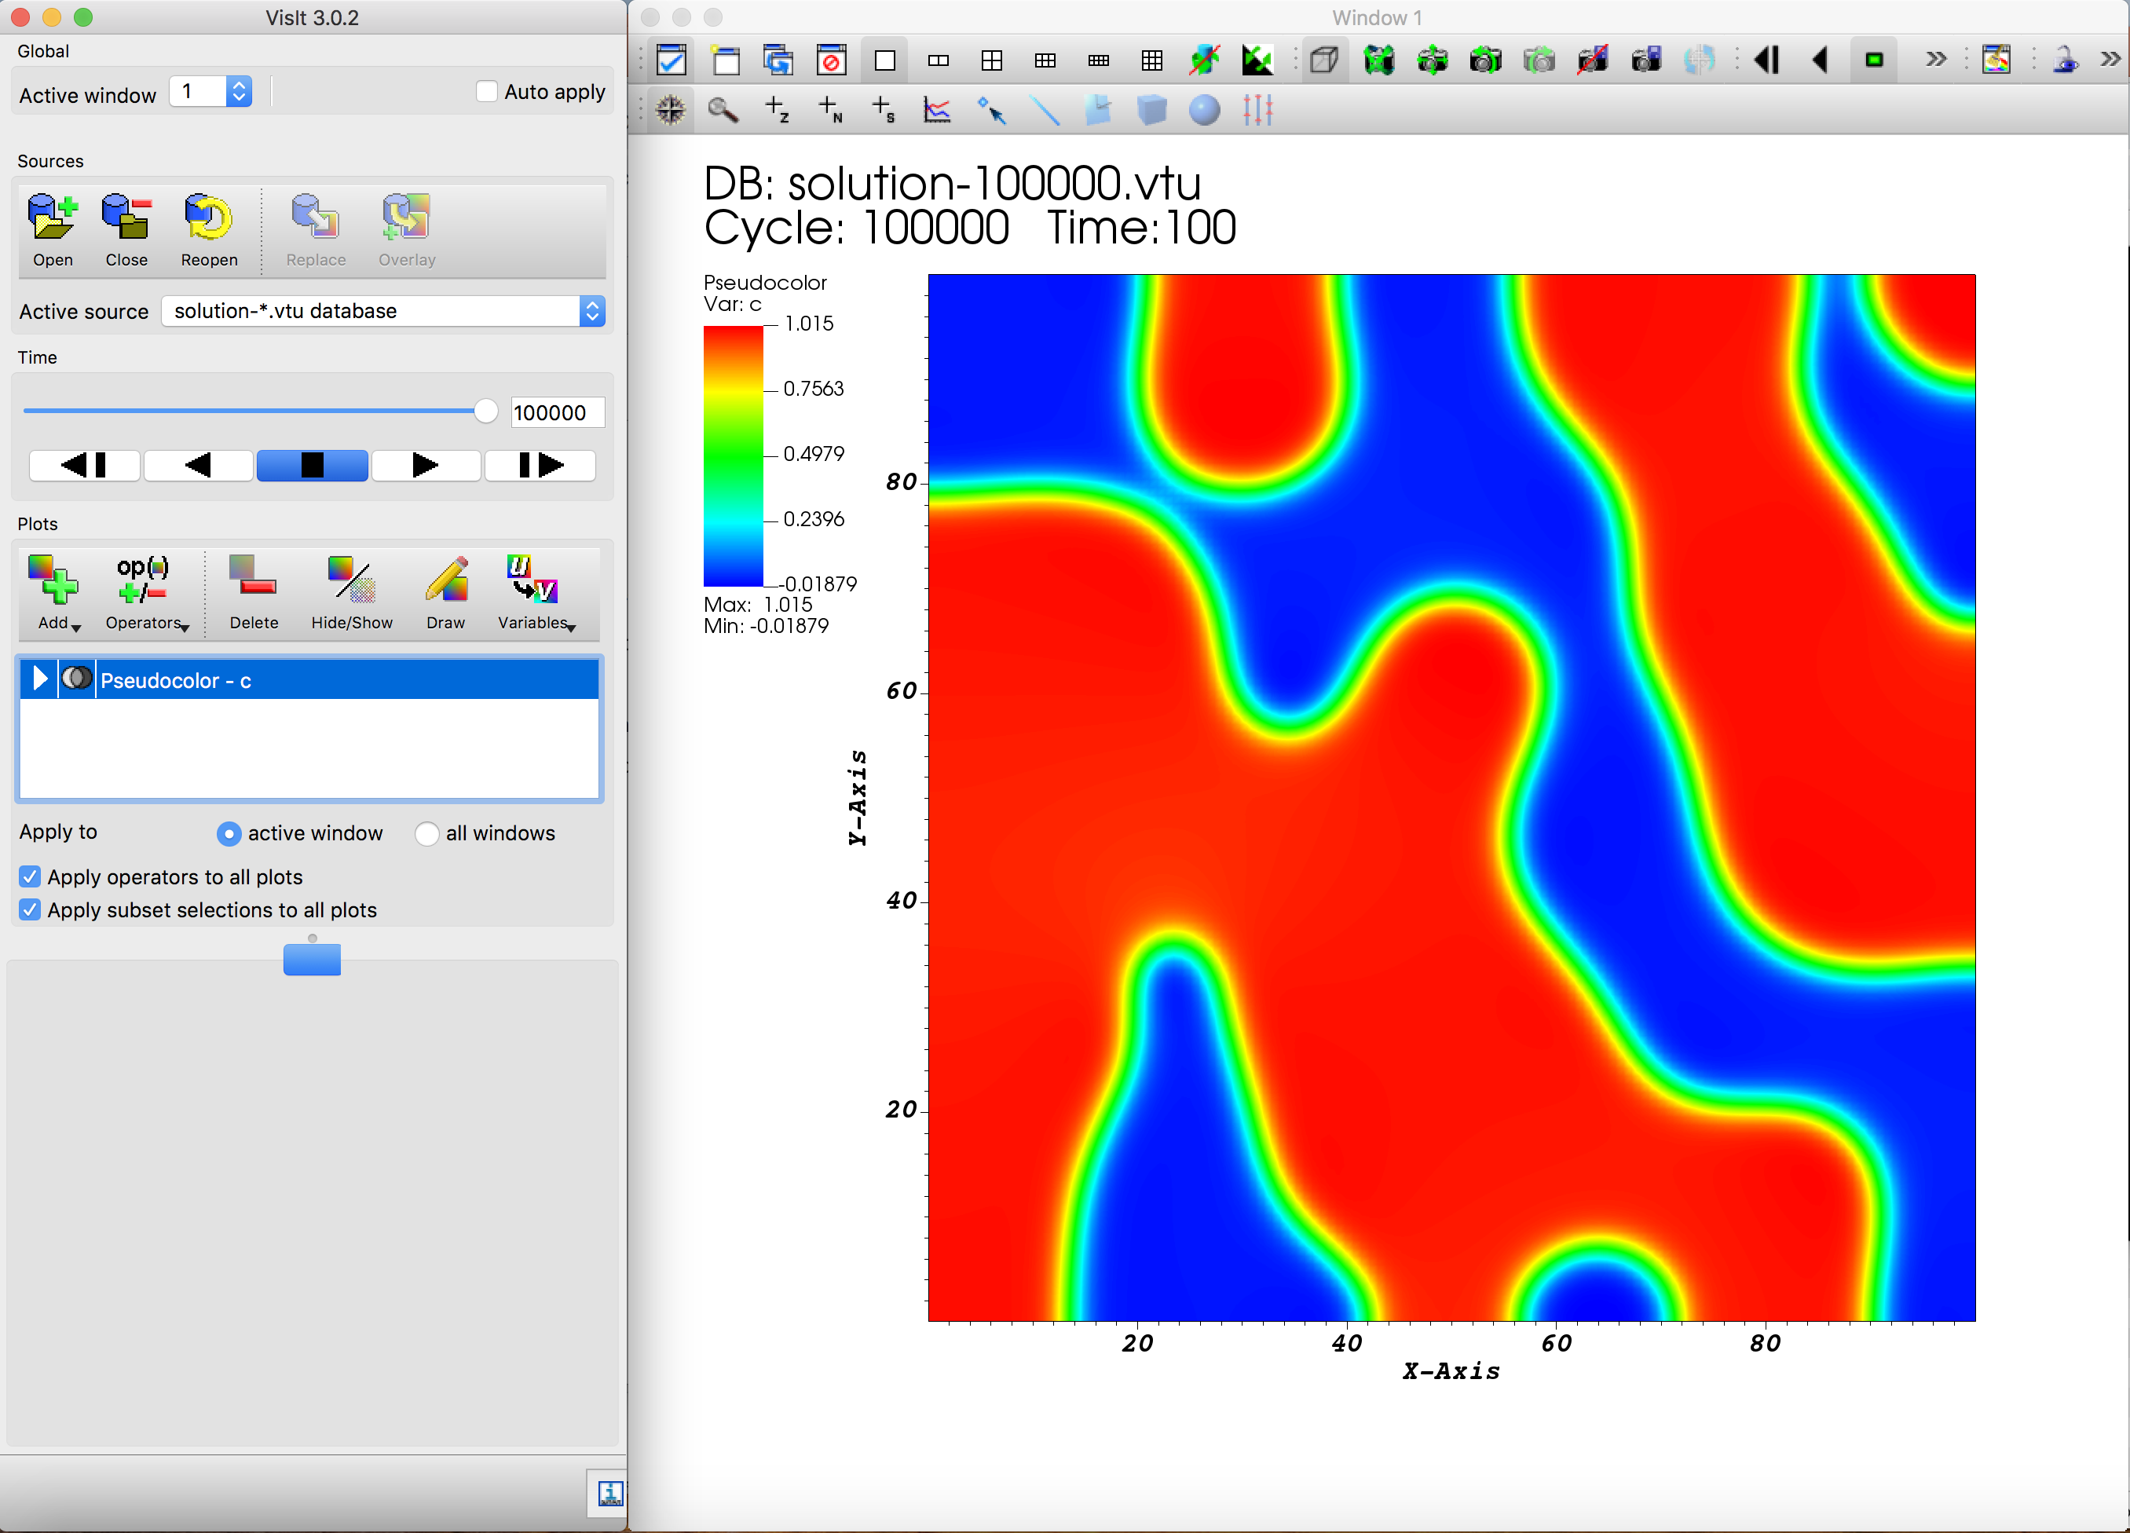
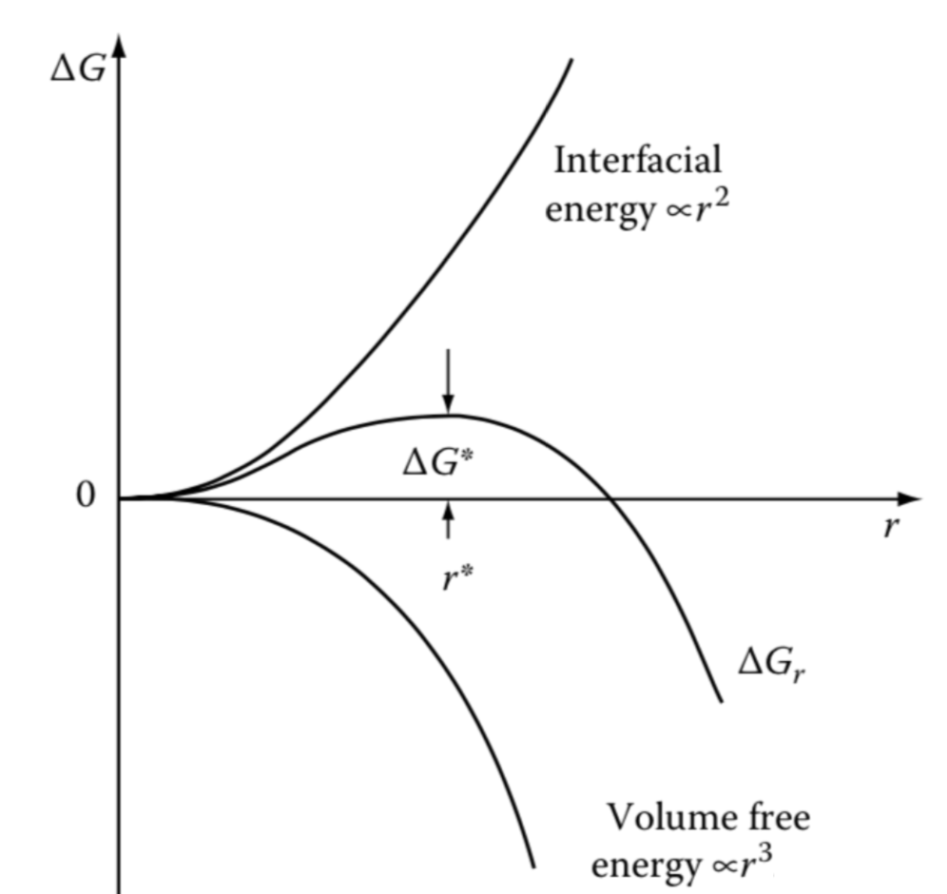
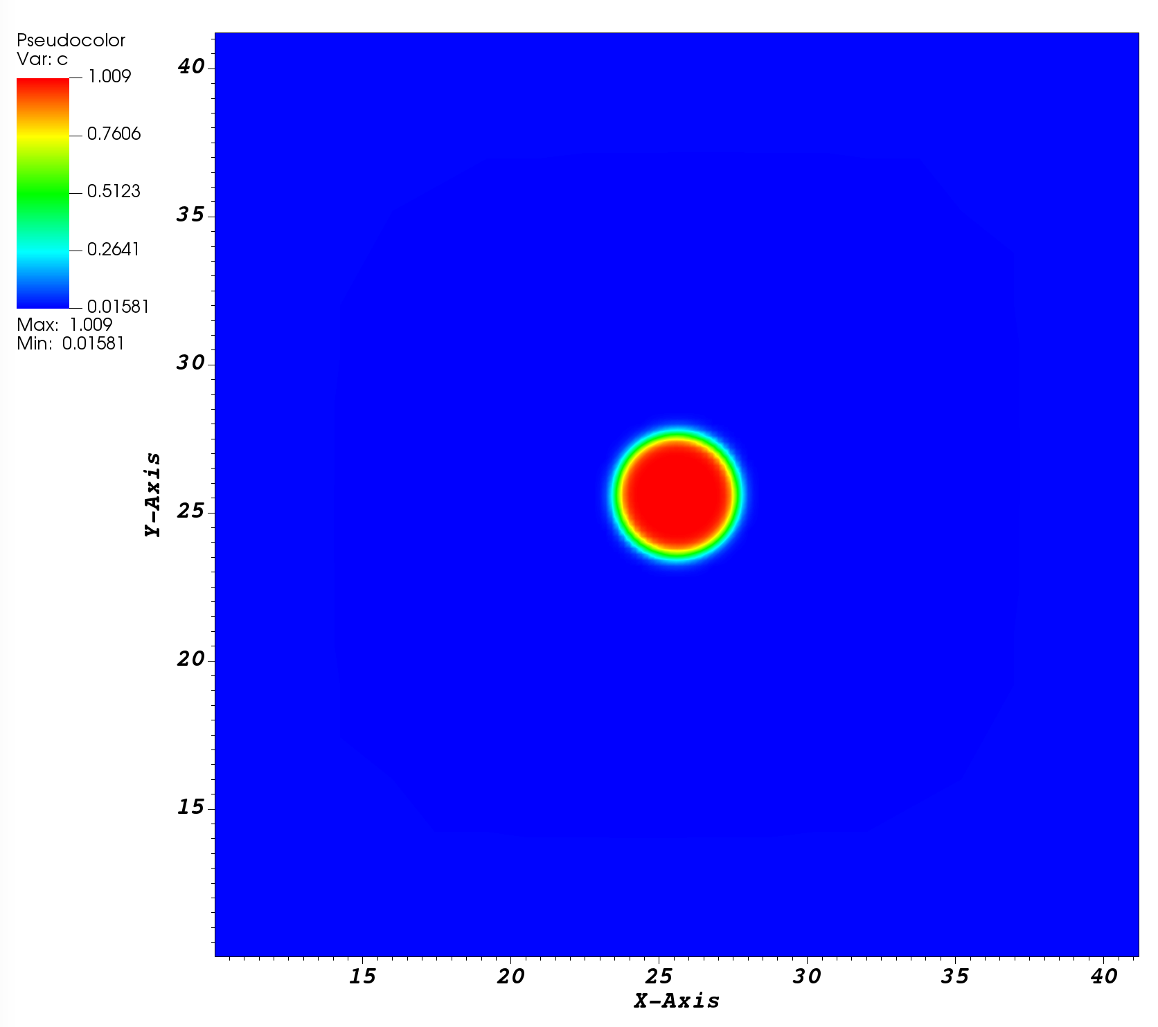
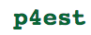




New and Upcoming Features - YouTube Video Tutorials
Installing, running, and visualizing results
Installation of prerequisites
Nucleation and Growth
PRISMS-PF
Coming soon:
Spinodal Decomposition
Advanced Application
36
Notes:
Another recent development is a series of tutorial videos that are available in the PRISMS Center YouTube channel which has over 200 subscribers (I will post the link at the end of the presentation but it is also quite easy to search for it).
We have uploaded 4 tutorial videos so far:
One for installing PRISMS-PF, running a pre-built application, and visualizing the results.
Another one with a step-by step guide to the installation of prerequisites, namely, deal.II with the MPI and p4est dependencies. And visualization software packages, either VisIt or ParaView.
Another one in which we create a simple new application to simulate the evolution of a circular seed near its critical size. In this example we go through each of the application files and edit them accordingly.
And, finally, one that showcases phase separation following spinodal decomposition.
We plan to continue adding tutorial videos which will have examples on how to create new applications of increasing complexity, with the goal of familiarizing users with the different features of the framework.

Slide 37

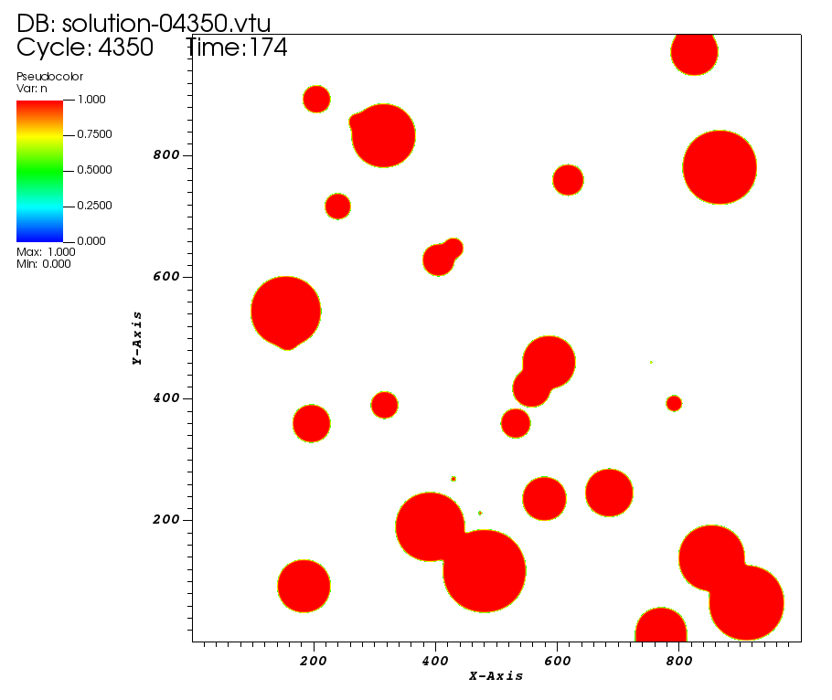
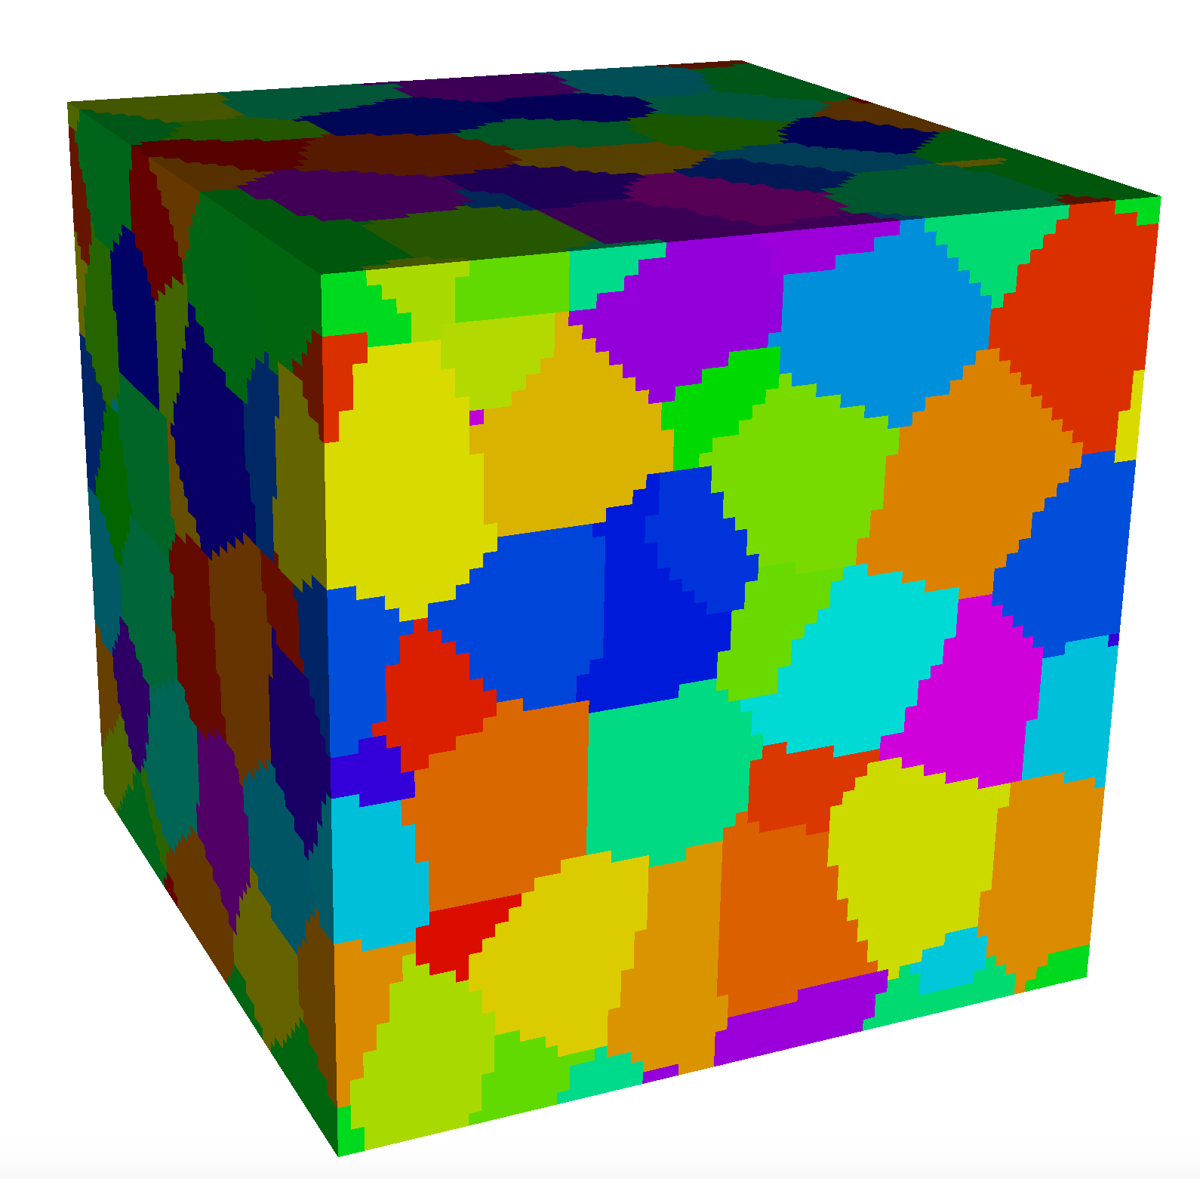
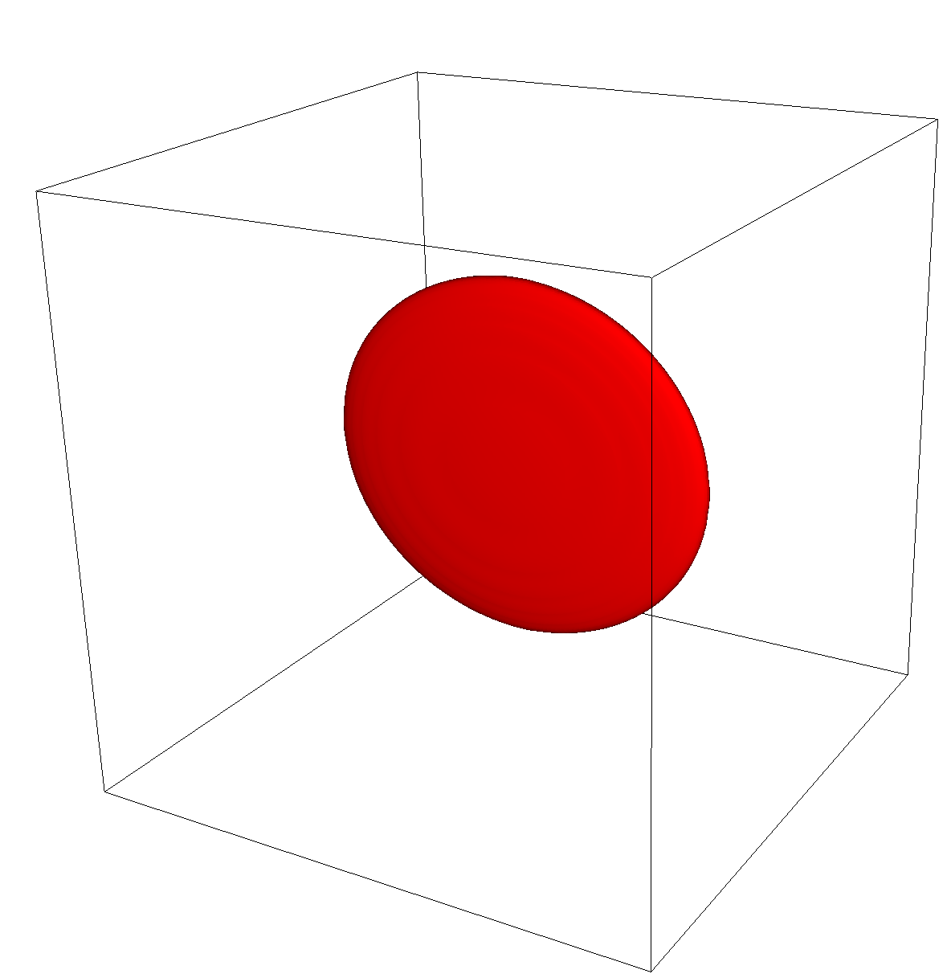
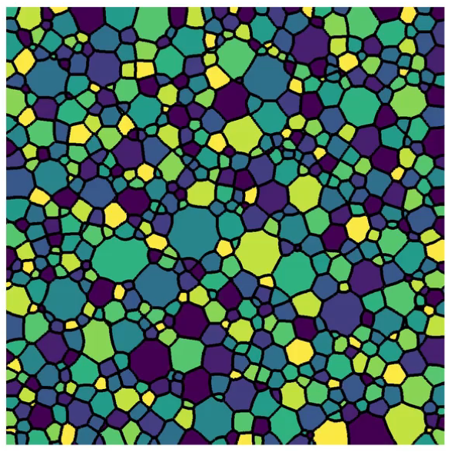
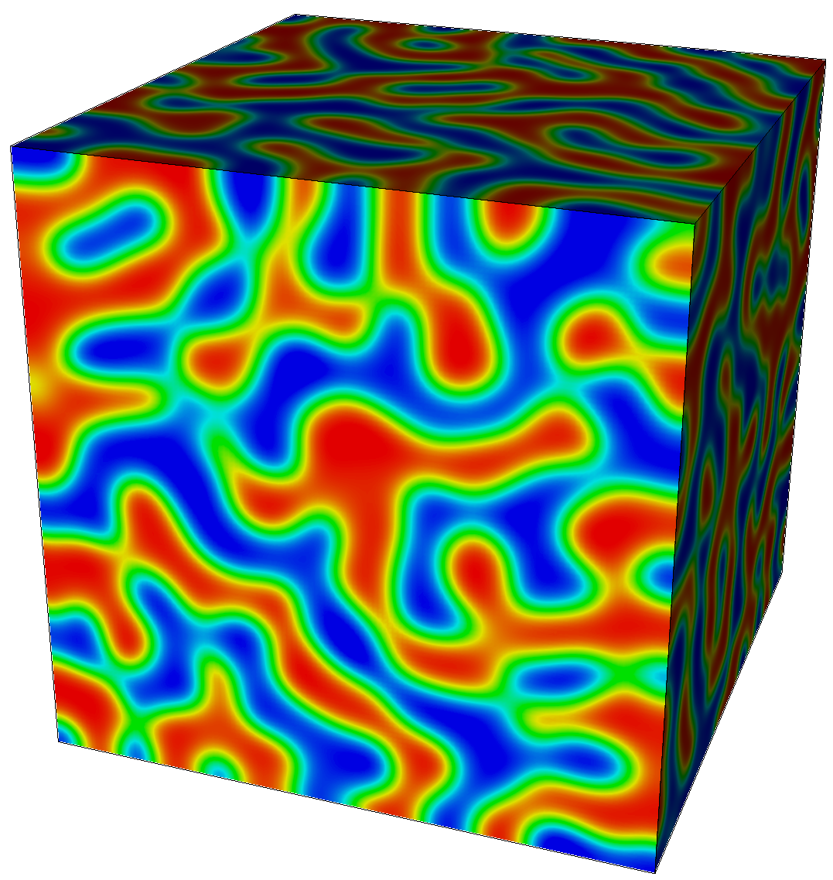
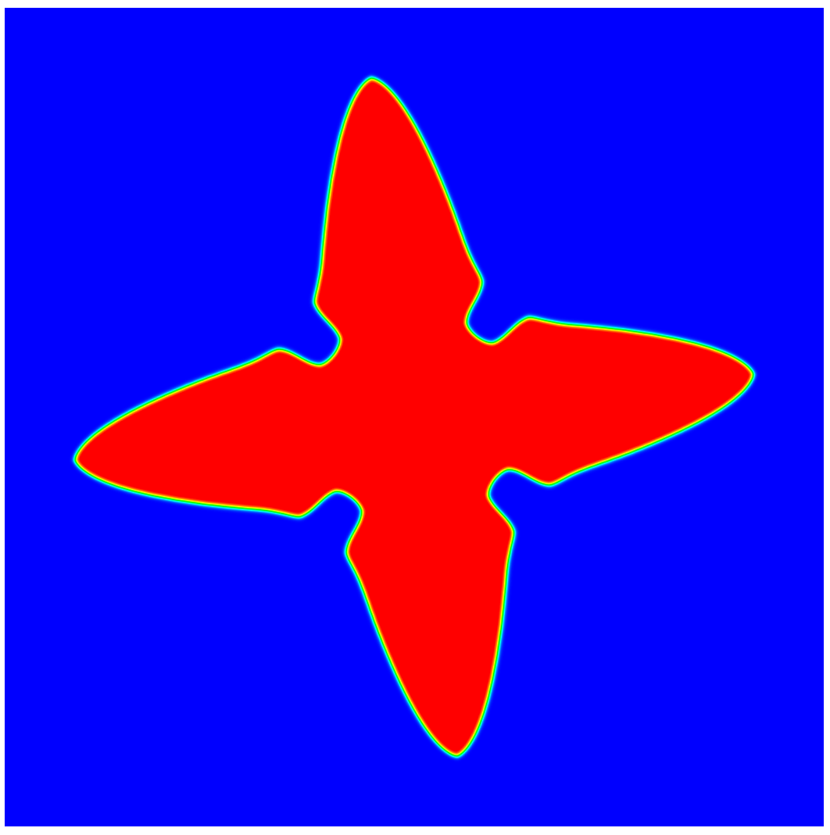

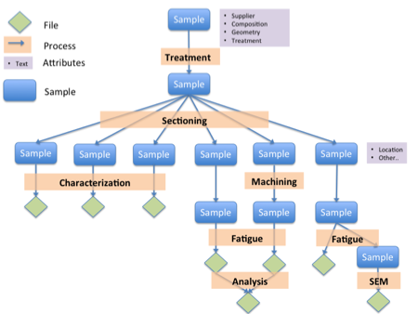
New and Upcoming Features - Integration Tools
Postprocessing scripts
Integration with DREAM.3D
New scripts for results analysis of PRISMS-PF simulations:
Recently upgraded script to import microstructure from DREAM.3D (using the VisIt CLI)
Phase fraction
Interface area
Domain count
… more to come
Materials Commons CLI
The newly-developed CLI for Materials Commons will facilitate creating scripts to automate the creation of projects, upload data, create and publish datasets, and edit communities of practice
37
Notes:
Here are some of our recent efforts towards integrating PRISMS-PF with other computational tools.
First, we have a recently upgraded script to import microstructure from DREAM.3D using the VisIt CLI. This feature is very useful for grain growth simulations.
We have new postprocessing scripts that take the ouput files from PRISMS-PF simulations and automatically calculate useful properties like phase fraction, interface area (or interface length in 2D) and domain count. We have plans to continuously add new scripts that meet the most common needs for users.
Finally, the newly-developed CLI for Materials Commons will facilitate creating scripts to automate the creation of projects, upload simulation results, create and publish datasets, and edit communities of practice.

Slide 38
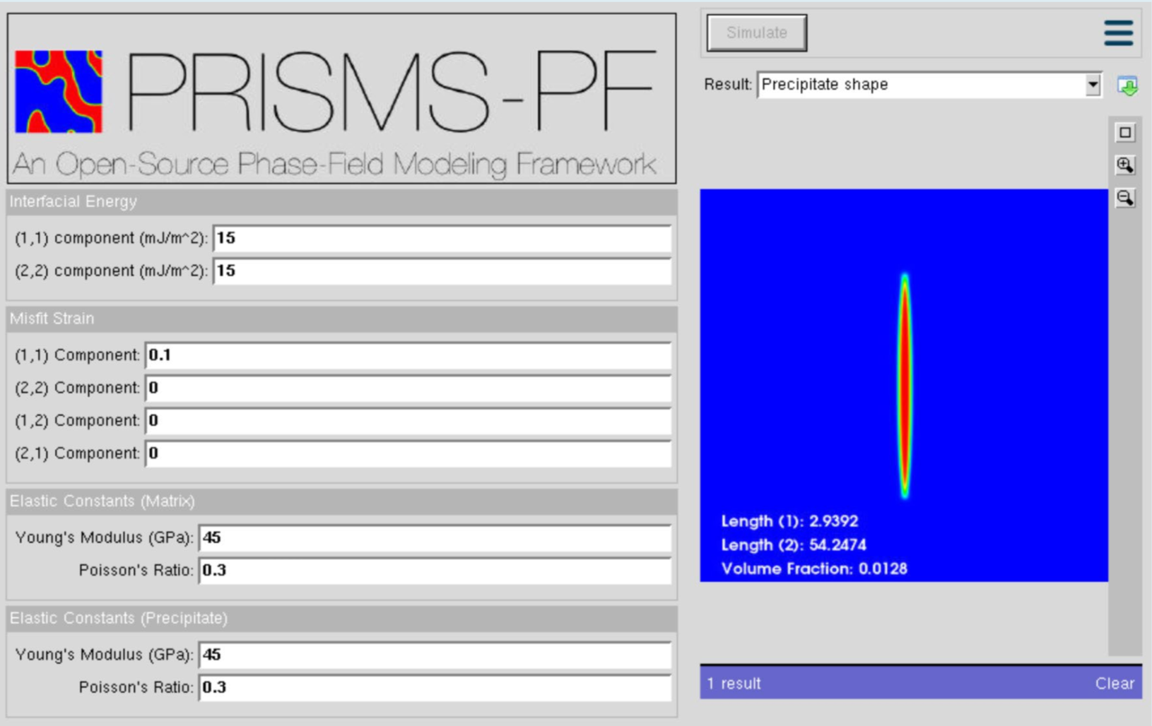
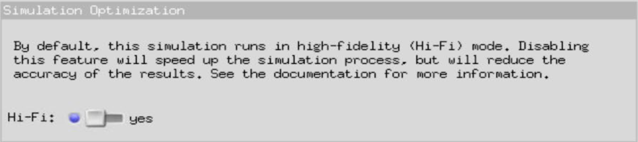
PRISMS-PF nanoHUB Module
https://nanohub.org/resources/prismspfmisfit
PRISMS-PF: Equilibrium Shape for a Misfitting Precipitate*
2D equilibrium shape of a precipitate taking into account the effects of interfacial and strain energy
Targeted for classroom use
Recently optimized to include a low-fidelity option which produces a faster, preliminary calculation
*S. DeWitt (UM), N. Shuman (UC Davis), and S. Gentry (UC Davis)
38
Notes:
Very briefly, I would like to talk about a nanoHUB application based on PRISMS-PF. You can access it via the link shown on top of this slide.
This application calculates the 2D equilibrium shape of a precipitate taking into account the effects of anisotropy in interfacial and strain energies.
It is targeted for classroom use. The idea is that students can understand the effect of each of the parameters by setting different combinations of values.
And it was recently optimized to include a low-fidelity option which produces a faster, preliminary calculation.

Slide 39
Ongoing and Future Development
Applications (ongoing development)
Static recrystallization (coupled with PRISMS-Plasticity)
Additive manufacturing - Tom Flint (University of Manchester, UK), Bryan Kinzer (UM), Bonnie Whitney (WPI)
Fluid dynamics - Xianyue Liu (SUSTech, China)
Performance improvement
Implementation of GPU acceleration capability
Adaptive time-stepping
Nonzero Neumann boundary conditions
Integration and ease-of-use
Integration with Thermo-Calc for direct access databases that contain thermodynamic and kinetic information
Integration with CASM for loading free energy surfaces
Adding integration with Materials Commons to existing NanoHUB tool
Expand postprocessing suite
39
Notes:
Some of the ongoing and future development plans include:
New applications.
Since the topic today is texture evolution, I will briefly talk about the ongoing development of the recrystallization application in the next two slides.
But we also have two exciting applications from external developers: one for additive manufacturing and another one for fluid dynamics.
Then for performance improvement,
We plan to implement GPU acceleration capability
Also, an adaptive time step functionality,
Add an option to implement nonzero Neumann boundary conditions
For integration and ease of use:
We will build an integration tool with Thermo-Calc for direct access databases that contain thermodynamic and kinetic information.
We will also create an integration tool for loading free energy surfaces from CASM, which is another PRISMS framework.
We will expand the existing nanoHUB tool to add integration with Materials Commons
And also expand the postprocessing suite

Slide 40
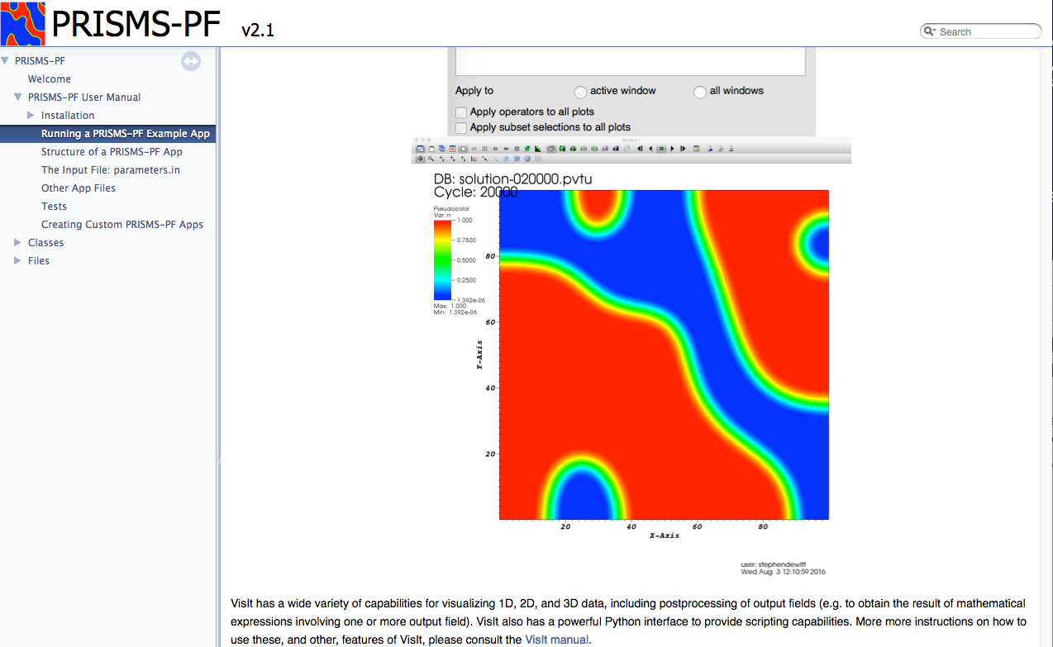



Community support
Online user manual
Online message board
( > 100 registered users)
Phase-Field Community
of Practice (NEW)
40
Notes:
Finally, I want to briefly talk about the community support for PRISMS-PF. We have an online user manual that is continuously being updated.
An online message board which has over 100 registered members and where users can ask for help with specific issues.
We also recently created a community of practice with the goal of facilitating users to share phase-field simulation results in the form of datasets.

Slide 41
Three Types of PRISMS-PF Users
Using pre-built applications
Modifying simulation parameters, boundary conditions, initial conditions.
No C++ or deal.II knowledge required
Creating new applications
Implementing governing equations and defining model parameters
Basic C++ knowledge required
No deal.II knowledge required
Developing new features and functionalities
Editing the core libary
Knowledge of C++ and deal.II required

Slide 42

Structure of PRISMS-PF
Core library
Generates mesh, does the finite element calculation, outputs files, etc.
Apps
Each app is a directory that contains an input file and some application files
Governing equations, boundary conditions, initial conditions, numerical and model parameters, postprocessing expressions
Using an app requires no C++ experience (parsed text input file)
Developing an app requires minimal C++ experience and no FEM experience
Tests
Suite of unit and regression tests
Continuous integration testing with Travis CI
Notes:
Here I just want to give a brief overview of the structure of PRISMS-PF
We have the core library, which is the backend part that performs all of the operations such as generating the mesh, applying the boundary and initial conditions, and doing the calculations at every timestep. It is designed so that a typical user will not have to interact with it.
Then we have applications. Each application has a directory that contains a file to input parameters and simulations settings, as well as a few other files where the user can set the governing equations, boundary conditions, initial conditions, and postprocessing expressions.
This was designed so that no C++ knowledge is required to use an application, and only minimal C++ knowledge is required to create a new applicarion
Moving on to tests, we have suite of unit and regression tests as well as continuous integration with Travis CI. The purpose of these tests is to ensure that PRISMS-PF continues to work properly as new features are added.
And finally, we have posts-processing scripts, which are Python scripts for data analysis using the VisIt cli. I will come back to these scripts later.

Slide 43
Structure of an application
Code files (all applications):
main.cc – Parses user input data, builds the fields, loads initial conditions, calls the solver method.
parameters.in – Text file with input data: system dimensions, mesh specification, time step, boundary conditions, output format and frequency, and user-defined simulation parameters.
equations.cc – Declare the expressions (weak form) for the time dependent and time-independent equations
ICs_and_BCs.cc – Set the initial conditions and non-uniform Dirichlet boundary conditions (if applicable).
customPDE.h – Declare user-defined simulation parameters defined in parameters.in. Declare application-specific methods, or override methods from the core library.

Slide 44
Structure of an application
Code files (optional):
postprocess.cc – Defines fields needed for analysis of the results, but not necessarily for the simulation, e.g., the free energy density.
nucleation.cc– Defines the method to calculate the probability of nucleation (only needed when nucleation is enabled).

Slide 45
APPLICATION DEMO
allenCahn
Free energy
functional
“Double well” free energy with minima at and
Dynamics

Slide 46
APPLICATION DEMO
Derivation of weak form of equations (Allen-Cahn model)
Free energy
functional
Governing equation
Time discretization
(forward Euler method)

Slide 47
APPLICATION DEMO
Derivation of weak form of equations (Allen-Cahn model)
To obtain the weak formulation of the governing equation(s) we multiply both sides an arbitrary variation, ω, and integrate over the volume Ω:
Rearranging terms, we have

Slide 48
Interactive Session

Slide 49
APPLICATION DEMO
2. Cahn-Hilliard
Free energy
functional
“Double well” free energy with minima at and
Dynamics

Slide 50

APPLICATION DEMO
2. Cahn-Hilliard

Slide 51
APPLICATION DEMO
3. Coupled Cahn-Hilliard/Allen-Cahn
Free energy
functional
Free energy curves
for phases α and β
(Interpolation function)
Dynamics

Slide 52

APPLICATION DEMO
3. Coupled Cahn-Hilliard/Allen-Cahn

Slide 53


Thank you!
Interested in PRISMS-PF?
Website: https://prisms-center.github.io/phaseField
Repository: https://github.com/prisms-center/phaseField
PRISMS Center YouTube Channel: https://www.youtube.com/channel/UCZXc3007JuBCGKDcneD_umA
Email: prismsphasefield.dev@umich.edu
PRISMS-PS Training Sessions
Monday 10-12 EST (8/9/2021)
Wednesday 10-12 EST (8/11/2021)
Notes:
With that I conclude this presentation.
Here are some links and contact information that may be helpful if you are interested in PRISMS-PF, either as a user or as a developer.
Thank you for your attention!

